Slide 1


Applying for Financial Aid
2013-2014
Notes:
Thank you for coming to our California Cash for College workshop.
Today, we will be discussing how to apply for financial aid for the 2013-14 academic year.

Slide 2
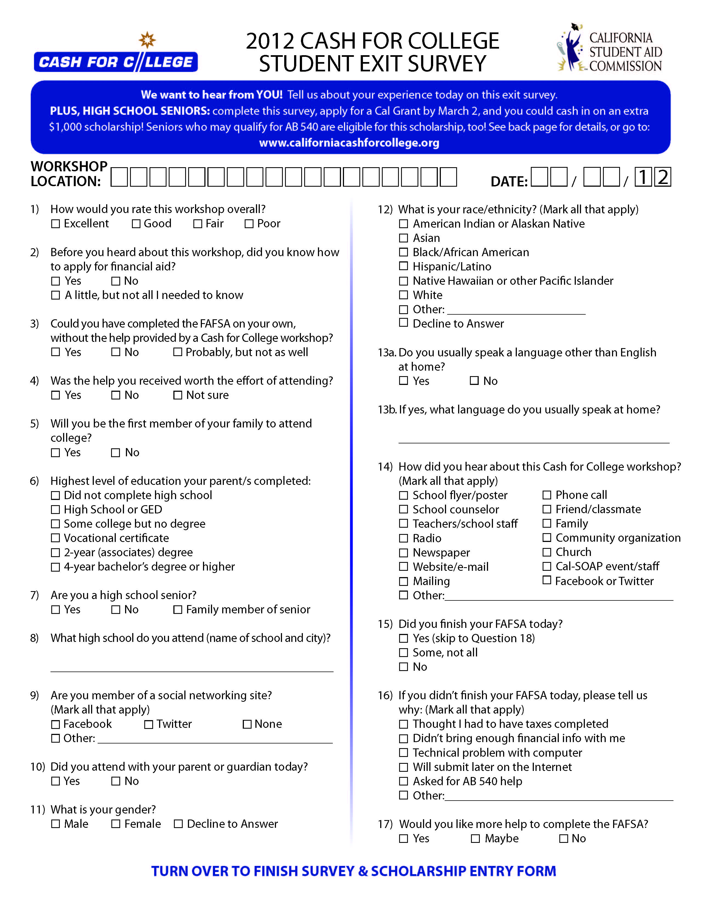
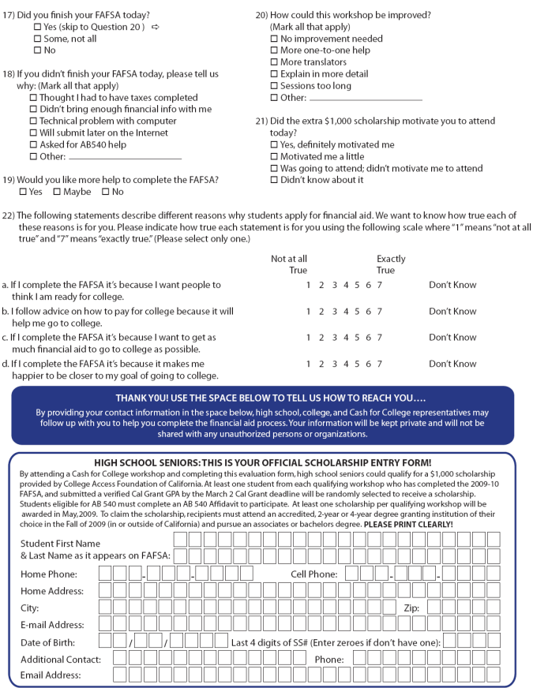
Cash for College $1,000 Scholarship
Evaluation
Complete ONLINE or turn in the Student Evaluation BEFORE you leave!
Location and Date
Write Clearly!
Scholarship Rules on pg 2
Must submit your FAFSA and
Cal Grant GPA by March 2nd
Winner will be chosen after March 2nd and announced by your counselor or by a letter mailed to the address provided.
Scholarship will be sent to the college.

Slide 3

Types of Financial Aid
Gift Aid - Grants or scholarships that do not need to be repaid
Work - Money earned by the student as payment for a job on or off campus
Loans - Borrowed money to be paid back, usually with interest
Notes:
There are three major types of financial aid – grants and scholarships, work-study, and educational loans.
Grants and scholarships are gift aid that does not require repayment. Grants are usually based on the student’s financial need. Scholarships are generally based on talent and/or merit.
While there are a number of grants and scholarships available to California students, the Cal Grant program is one of the most important and valuable. Cal Grants are an example of gift aid based on need and merit. We will discuss Cal Grants in more detail later in the presentation.
Work-study programs provide opportunities for students to earn money to help pay for school expenses.
Both students and parents can borrow from a variety of low interest educational loan programs designed to help with the educational expenses of the student. Student loans usually do not require repayment until the student is no longer in school. Parent loans may require payment while the student is still in school.

Slide 4

Sources of Financial Aid
Federal government
State government
Colleges and universities
Private agencies, companies, foundations, and parents’ employers
Notes:
By completing the financial aid applications and any other documents required by the colleges and universities to which the students are applying, they may be considered for funds from:
- the federal government
- the state government, as well as
- colleges and universities themselves
Private agencies, companies, foundations, and maybe even the parents’ employers provide scholarships for college. Though important, these sources provide less than 6% of the total financial aid awarded to students. Check with each of the private agencies, companies, and foundations to which the students wish to apply about application forms and deadlines. Web sites such as www.fastweb.com and www.finaid.org are good resources for such scholarships.

Slide 5
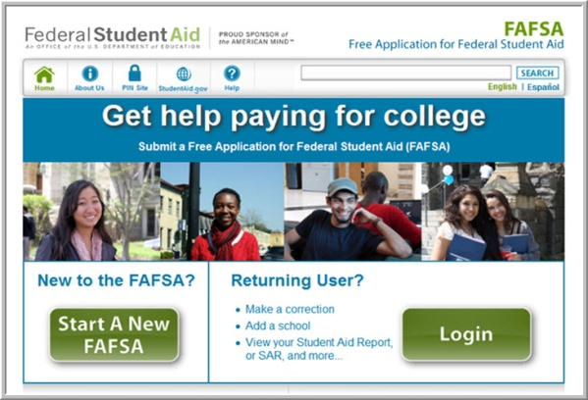
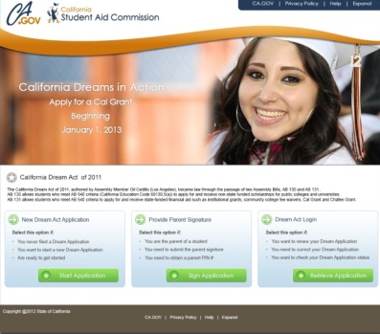
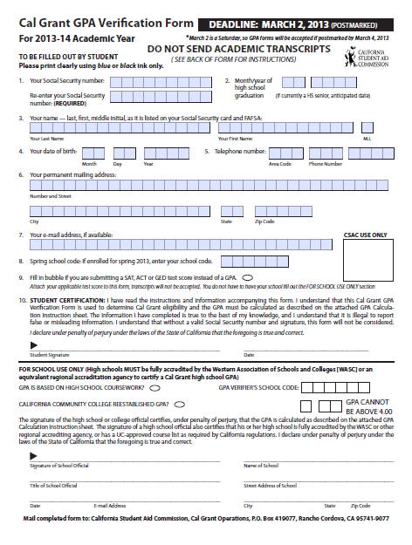
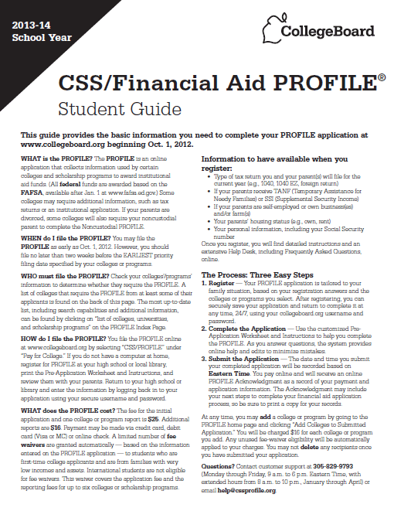
Types of Applications
FAFSA
Undocumented student covered under AB540 should complete the California Dream Application
Cal Grant GPA Verification Form
Other applications or forms as required by the college such as:
CSS/Financial Aid PROFILE
    Institutional Scholarship and/or Financial Aid Application
2012 federal tax returns (along with all schedules and W-2s) or other income documentation
Notes:
There are a number of important financial aid forms:
-The Free Application for Federal Student Aid (FAFSA) is required by all colleges and universities for the awarding of federal and state aid. Every student should complete the FAFSA. In some instances, a school may use the FAFSA for institutional aid as well. The FAFSA should be completed by students and their families in electronic format (FAFSA on the Web). We will discuss the FAFSA on the Web in greater detail in just a few minutes
- Undocumented students covered under AB540 should complete the California Dream Application.
-As previously mentioned, in order to be considered for a Cal Grant, students must also complete the Cal Grant GPA Verification Form. This form must be certified by their high school and submitted to the California Student Aid Commission (CSAC) by March 2, 2013.
-The CSS/Financial Aid PROFILE is used by many private or independent colleges and universities as well as a few public universities outside of California to determine eligibility for their own funds. Some scholarship competitions may also require the CSS PROFILE.
-Some colleges or universities may require their own scholarship or financial aid applications in addition to the FAFSA. The additional forms , such as those for the Community College Board of Governors (BOG) Fee Waiver, may collect information not requested on the FAFSA. These forms help the institution award its own funds and must be returned to the college or university directly.
-As noted earlier, many employers, organizations, and community-based agencies offering scholarships require students to complete separate applications.
-Many colleges will request copies of student and parent 2012 federal tax returns and other income documentation. We suggest the student and parents complete their 2012 federal income tax forms as soon as possible. Make sure to keep copies of these forms along with all schedules and W-2’s.
-Also be sure to submit any required applications or requested documents by the published deadlines. At many institutions, failure to meet a deadline may jeopardize student eligibility for grants and other types of aid. We cannot emphasize this enough – don’t miss out by missing a deadline.

Slide 6

How Does Financial Aid Work?
  Colleges determine and offer their students financial aid based on the following equation.
  Also known as “Need Analysis.”
Cost of Attendance (COA)
Expected Family Contribution (EFC)
Financial NEED (Financial Aid Eligibility)

Slide 7
Cal Grants
Cal Grant A Entitlement Awards – for high school seniors and recent high school grads with a Grade Point Average (GPA) of at least 3.0, family income and assets below the state ceilings, who demonstrate financial need
Cal Grant B Entitlement Awards – for high school seniors and recent high school grads with a GPA of at least 2.0, who come from disadvantaged or low income families, whose family income and assets are below the state ceilings, and who demonstrate financial need
Cal Grant C Awards - for students from low income families pursuing vocational programs of study
Notes:
Let’s talk about Cal Grants – an important source of grant funds provided by the state of California for California students. Students planning to attend a California college or university may be eligible to receive one of the following Cal Grants. High school Grade Point Average (usually referred to as the GPA) is an important eligibility criterion for these grants. The Cal Grant GPA is calculated using grades from sophomore and junior years of high school and any summer grades after each of those years.
Please note: for purposes of the Cal Grant A and B Entitlement Awards, a “recent high school graduate” is defined as a student who is applying for a Cal Grant within 18 months of high school graduation.
Cal Grant A - To be eligible, students need a minimum 3.0 GPA - that is a B average on a 4.0 scale - and must demonstrate financial need of at least $1,500 at the college they plan to attend. Their families must also have income and assets that are lower than the state-established ceilings. This grant currently covers system-wide fees at the California State University and University of California campuses and up to $9,223 of tuition and fees at independent California colleges and universities. The grant may be renewable for three additional years if student and family continue to meet state-established income and asset ceilings.
Cal Grant B - This grant is for students who have a minimum 2.0 GPA - that is a C average, financial need of at least $700, and who come from very low-income families. Students must also meet the other criteria mentioned already. This grant provides a small stipend of about $1,551 per year for up to four years to help with living expenses at all schools. In addition, the grant covers system-wide fees at California public 4-year institutions and up to $9,223 of tuition and fees at independent 4-year California schools. In most cases, the tuition and fee portion of the Cal Grant B is available to students in their 2nd through 4th years only.
Cal Grant C - This grant is for students from low income families attending occupational or vocational schools including community college programs of less than 24 months in length. The Cal Grant C may renewable for one additional year if student and family continue to meet state-established income and asset ceilings.
Priority for Cal Grant C now given based on Occupational Goals that meet two of the following:
high employment need:
high employment growth;
and high wages.
.

Slide 8

Eligibility for Cal Grants
To be eligible for a Cal Grant, the student must also:
  be a U.S. citizen, eligible noncitizen, or AB540 student
  be a California resident
  attend an accredited California college or university at least half-time in 2013-14
Notes:
To be eligible for a Cal Grant, the student must also:
be a U.S. citizen or eligible noncitizen as defined in the Free Application for Federal Student Aid (FAFSA).. If a student qualifies under AB540, he/she may qualify for Cal Grant. We’ll talk more about what this means later in the session
be a California resident
attend an accredited California college or university at least half-time in the 2013-2014 academic year and each term the student is enrolled.

Slide 9


California Chafee Grant
The California Chafee Grant program provides up to $5,000 annually to current and former foster youth for college or vocational training at any accredited college in the U.S., based on available funding
To be eligible, foster youth must have been in California foster care on their 16th birthday and not have reached their 22nd birthday before
July 1, 2013
Foster youth are encouraged to apply during their senior year of high school
To apply, the foster youth must complete:
  2013-2014 FAFSA
  California Chafee Grant Program Application
  AB540 students may also be eligible
To apply for a
Chafee Grant, go to: www.chafee.csac.ca.gov
Notes:
If the student is a foster youth, the California Chafee Grant may provide some additional financial aid for college. If you are the foster parent or know a foster youth, tell him/her about this special program for foster children.
The California Chafee Grant program provides up to $5,000 annually to current and former foster youth for college or vocational training at any accredited college in the U.S. The continued availability of this grant is dependent on available funding.
To be eligible, foster youth must have been in California foster care on their 16th birthday and may not have reached their 22nd birthday before July 1, 2013.
Students are encouraged to apply during their senior year of high school.
To apply, the foster youth must complete:
- 2013-14 FAFSA
- AB540 students should complete the California Dream Act Application in place of the FAFSA
- California Chafee Grant Program Application
To learn more about the Chafee Grant, go to
www.chafee.csac.ca.gov

Slide 10

Undocumented Students
If the student is undocumented
and is applying to any California public college or university, check to see if he/she might be eligible for in-state tuition/fee costs under AB540
If eligible for AB540, apply for California Dream Act financial aid at www.caldreamact.org
check with colleges and universities about CA Dream Act institutional financial aid and private scholarships and the timelines for applying
apply for all other private scholarships for which the student may be eligible
start inquiring in elementary, middle or high school to see if it is possible for younger students to become permanent residents
  For more information and a list of scholarships, go to:
  www.maldef.org/assets/pdf/MALDEF_Scholarship_Resource_Guide.pdf
  www.caldreamact.org
  www.e4fc.org
Notes:
If the student is undocumented, he/she may qualify for in-state tuition/fee costs through state law (AB540). The California Dream Act (AB130 and 131) provides access to private scholarships administered by public colleges and universities and state financial aid.
Learn more about the Dream Act, go to the California Student Aid Commissions website at www.caldreamact.org.
AB130 – Part 1 CA Dream Act
Signed into law on July 25, 2011
Became effective January 1, 2012
Allows students who meet AB540 criteria to apply for and receive available private scholarships administered through the public colleges and universities, including scholarships funded through private donors, alumni contributions, or individual departmental efforts
For information about how and when to apply, AB540 students must contact their public college/university financial aid offices
AB131 – Part 2 CA Dream Act
Signed into law on October 8, 2011
Became effective January 1, 2013
Allows students who meet AB540 criteria to
Apply for & receive institutional grants like UC Grant, State University Grant, Educational Opportunity Program and Educational Opportunity Program & Services fee waivers
Apply for & receive Board of Governors fee waivers at the California Community Colleges
Apply for & receive state financial aid, including Cal Grants and Chafee Foster Youth Grant for use at eligible institutions
Cal Grant online application (Dream App) will be activated after January 1, 2013 to gather financial & other information
Dream Act Cal Grants may be first used in the 2013-2014 school year
Dream applicants must meet all other Cal Grant requirements
For information about how and when to apply for institutional grants and fee waivers, AB540 students must contact their financial aid offices
Students should also:
apply for all private scholarships for which they may be eligible
For a list of scholarships for undocumented students, go to:
Mexican American Legal Defense Fund (MALDEF)
maldef.org/assets/pdf/MALDEF_Scholarship_Resource_Guide.pdf
California Dream Act: www.caldreamact.org
Educators for Fair Consideration: www.e4fc.org
Watch for changes in federal and state laws regarding the eligibility of undocumented students.
If students have questions about Deferred Action, please refer to www.uscis.gov and www.e4fc.org
If parents have younger children, they should start inquiring in elementary, middle or high school to see if it is possible for the students to become permanent residents.
For more information, contact the Mexican American Legal Defense and Education Fund (MALDEF). Call (213) 629-2512

Slide 11

Special Circumstances
Contact the Financial Aid Office if there are circumstances which affect a family’s ability to pay for college such as:
  Loss or reduction in parent or student income or assets
  Death or serious illness
  Natural disasters affecting parent income or assets such as the recent California wind storms, wild fires, floods, or mudslides
  Unusual medical or dental expenses not covered by insurance
  Reduction in child support, Social Security benefits or other untaxed benefit
  Financial responsibility for elderly grandparents, or
  Any other unusual circumstances that affect a family’s ability to contribute to higher education
Notes:
Special Circumstances
As mentioned earlier, many families have special circumstances not reflected by the questions on the FAFSA. Families are encouraged to contact the Financial Aid Office at each of the schools to which they are applying for admission and financial aid if there are significant changes in their circumstances such as:
A loss or reduction in parent or student income or assets
A death or serious illness
Natural disasters that affect parent income or assets – this is especially true for any family adversely affected by the recent California wind storms, wildfires, floods, or mudslides
Unusual medical or dental expenses not covered by insurance
Reduction in child support or Social Security benefits
Financial responsibility for elderly grandparents, or
Any other unusual circumstances that affect a family’s ability to contribute to higher education.
If the family feels there are special circumstances that may affect their ability to contribute to college, it is important that they present their case in a way that helps the financial aid office understand their unique challenges. Some schools will provide special forms to help the family provide the appropriate new information. Families are encouraged to:
Contact the financial aid office for guidance
Write a detailed explanation of circumstances
Include student’s name, college or university ID#, and date of birth
Give specific financial details including the reasons why the circumstances affect the family’s ability to contribute
Attach supporting documentation
Send to the financial aid office at each school to which the student is applying
Each financial aid office will make its own decision about the effect the special circumstances have on a student’s need. Not all aid offices will be able to provide additional funds if there are special circumstances, but they might be able to suggest other options.

Slide 12

FAFSA on the Web (FOTW)
Internet application used by students and parents to complete electronic FAFSA at:
www.fafsa.gov
Sophisticated on-line edits and skip logic help avoid errors
On-line help is available for each question
Student and one custodial parent should get a federal PIN to sign FAFSA at:
www.pin.ed.gov
Notes:
FAFSA on the Web
The primary benefit of using FAFSA on the Web (FOTW) is that the processing time is significantly reduced. Students and schools receive a response from the federal processor more quickly, which in turn assists schools in preparing a more timely notification of eligibility for financial aid. (This is a definite advantage if you are trying to decide between two or more schools.)
Other benefits are:
Fewer errors on the form. Built-in edit checks will not allow the family to go to the next section if something is left incomplete in a prior section. Before submitting the FAFSA, the program will do a final review of the entire application, checking for missing and/or conflicting information.
Thanks to skip logic, there are fewer questions to complete. This means that you will not be asked questions that do not apply to you. (Example: unmarried students will not be asked questions about a spouse.)
In many cases, drop down boxes are provided so the family can choose from a selection of responses.
Families who have submitted their 2012 federal income tax returns may be able to transfer IRS data directly to the FOTW.
As soon as the FAFSA on the Web is submitted, a confirmation page can be printed to instantly verify that the application has been submitted. This page will contain a Confirmation Stamp showing the date and time that the FAFSA was successfully submitted.
To take full advantage of FAFSA on the Web, remember that both the student and one of his or her custodial parents must have a federal PIN to electronically sign the FOTW.

Slide 13
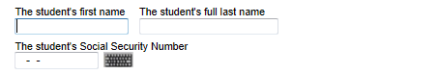
Section 1 - Student Name & Social Security Number
Double check the student’s Name and Social Security Number when entering it on the FOTW.
Both student name and Social Security Number will be compared through a database match.
Notes:
Student Social Security Number: We encourage students to refer to a copy of their actual Social Security card to help ensure the correct number is reported. A common mistake made by parents is to enter their own number or that of another sibling.
- it is important that both pieces of student data (name and SSN) match the Social Security card exactly, because the U.S. Department of Education conducts an electronic match of the student’s name and SSN with the Social Security Administration
-To apply for a Social Security Number (SSN) or to get a replacement Social Security card, contact the Social Security Administration (SSA) at (800) 772-1213 or go to their website at
www.ssa.gov
If a student has a “work-only” Social Security Number (SSN) issued through the new federal Deferred Action for Childhood Arrivals (DACA) policy, the student is NOT eligible for federal financial aid and therefore should not complete the FAFSA. If eligible under AB540, the student should apply for state financial aid under the California Dream Act at www.caldreamact.org.

Slide 14
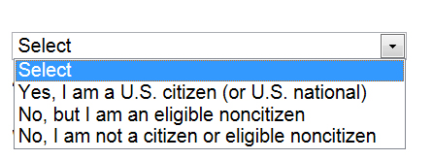
Section 1 - Student Citizenship Status
If U.S. citizen, status will be confirmed by Social Security match
If eligible noncitizen, status will be confirmed by Department of Homeland Security (DHS) match. This includes:
  U.S. permanent residents with I-551
  Conditional permanent residents with I-551C
  The holder of an Arrival-Departure Record (I-94) from the Department of Homeland Security showing any of the following designations: “Refugee,” “Asylum Granted,” “Parolee” (I-94 confirms paroled for a minimum of one year and status has not expired), T-Visa holder (T-1, T-2, T-3, etc.) or “Cuban-Haitian Entrant;” or
  The holder of a valid certification or eligibility letter from the Department of Health and Human Services showing a designation of “Victim of human trafficking.”
  A resident of the Republic of Palau (PW), the Republic of the Marshall Islands (MH), or the Federated States of Micronesia (FM)
  Canadian-born Native American under terms of the Jay Treaty
Notes:
14
14
Citizenship Status
Students must be U.S. citizens or eligible noncitizens to receive federal student financial aid and Cal Grants. If a student has recently become a U.S. citizen, he/she should contact the Social Security Administration (SSA) to update his/her status. Otherwise, when the U.S. Department of Education matches data with SSA, the Agency may report that the student is not a citizen and may be considered ineligible to receive federal and state aid.
For financial aid purposes, an eligible noncitizen is someone who meets one of the following criteria:
-A U.S. permanent resident with a Permanent Resident Card (I-551),or
-A conditional permanent resident with a Conditional Green Card (I-551C), or
-Other eligible noncitizen with an Arrival-Departure Record (I-94) from the Department of Homeland Security showing any of the following designations: “Refugee,” “Asylum Granted,” “Parolee” (I-94 confirms paroled for a minimum of one year and status has not expired), T-Visa holder (T-1, T-2, T-3, etc.) or “Cuban-Haitian Entrant;” or
-The holder of a valid certification or eligibility letter from the Department of Health and Human Services showing a designation of “Victim of human trafficking.”
- A resident of the Republic of Palau (PW), the Republic of the Marshall Islands (MH), or the Federated States of Micronesia (FM)
- A Canadian-born Native American under terms of the Jay Treaty.

Slide 15
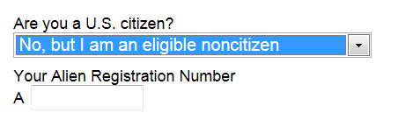
Section 1 - Eligible Noncitizen
If eligible noncitizen, write in the student’s eight- or nine-digit Alien Registration Number (ARN)
Precede an eight-digit ARN with a zero
Copy of the student’s Permanent Registration Card may be requested by the financial aid office
If neither a citizen nor eligible noncitizen, the student is ineligible for federal aid. Such students should check with their college financial aid office for other aid opportunities.
If the student is undocumented as defined in AB540, he/she may be eligible for state California Dream Act financial aid. Learn more at www.caldreamact.org
Notes:
15
15
Eligible Noncitizen
If students indicate “eligible noncitizen,” they should write in their 8- or 9-digit Alien Registration Number. Students should precede an 8-digit number with a zero.
Students who list their Alien Registration Number may be asked by the colleges or universities to provide a copy of their Permanent Registration Card.
Some recently naturalized citizens may also be asked to provide a copy of their Naturalization documents. It is legal to photocopy these documents for financial aid purposes.
Neither Citizen nor Eligible Noncitizen
If you are in the U.S. on:
- an F1 or F2 student visa;
- a J1 or J2 exchange visitor visa;
- a G series visa (pertaining to international organizations), or
- other categories not included under U.S. citizen and eligible noncitizen
you are not eligible for federal student aid and should not complete a FAFSA.
However, such students should check with their college financial aid office to see what kind of financial aid they may be eligible to receive and what forms they should complete.
The following students are not eligible to file a FAFSA or a California Dream Act Application and should contact their campus financial aid office for assistance to see what kind of financial aid they may be eligible to receive and what forms they should complete. These students are:
Non-immigrants granted one of the following visas: A, B, C, D, E, F, G, H, I, J, K, L, M, N, O, P, Q, R, S, TN, TD, V, TROV, and NATO.
T visa holders are eligible to apply for federal and California student financial aid. T visa holders should file a FAFSA and identify themselves as eligible non-citizens.
U visa holders are not eligible for federal student financial aid, but they are eligible for California student financial aid. U visa holders must file a California Dream Application.
If the student is undocumented as defined in AB540, he/she may be eligible for state California Dream Act financial aid. Learn more at www.caldreamact.org.
We will provide information about some free scholarship searches for students in one of these ineligible categories or who are undocumented students in the next slide.

Slide 16
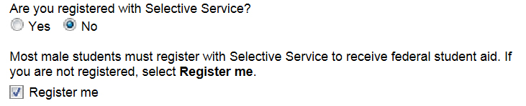

Section 1 - Selective Service Registration
All male students who are between the ages of 18 and 25 years must be registered with Selective Service to receive federal and/or state aid
Answer “Register me” only if you are male, aged 18-25, and have not yet registered.
The student may also register by going to:
www.sss.gov
Notes:
Selective Service Registration
All male students, regardless of citizenship status, who are 18 years of age or older must be registered with Selective Service to receive federal and/or state aid. This information will be confirmed with Selective Service.
Some colleges and universities will also require that the student be registered to receive institutional funds.
A student should answer “Register me” only if he is:
- male;
- currently between the ages of 18-25 (on the day the FAFSA is submitted); and
- NOT YET REGISTERED with Selective Service and would like the U.S. Department of Education to register the student with Selective Service.
If the student is male, but is 17 years of age or younger at the time the FAFSA is submitted, he should leave the question blank. The student must register with Selective Service when he turns 18. He can do this at the Selective Service Web site, www.sss.gov or fill out a Selective Service postcard at any U.S. post office.
If the student is unsure if he has registered, he may go to this same site to verify his registration status.
The following groups of students should leave this Worksheet question blank:
- female students;
- male students who are not yet 18 as of the date the FAFSA is submitted; and
male students who have already registered.
Female students should make sure they did not leave the earlier gender question blank.

Slide 17
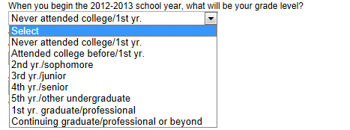

Section 1 - Grade Level in 2013-14
2013-2014
When the student begins the 2013-2014 school year, what will be his/her grade level?
  Never attended college/1st year
  Attended college before/1st year
  2nd year/sophomore
  3rd year/junior
  4th year/senior
  5th year/other undergraduate
  1st year graduate/professional
  Continuing graduate/professional or beyond
Notes:
Grade Level
If the student is a senior in high school, he/she should indicate “Never attended college/1st year.” The student should check this answer even if he/she has taken a college class while enrolled in high school.

Slide 18
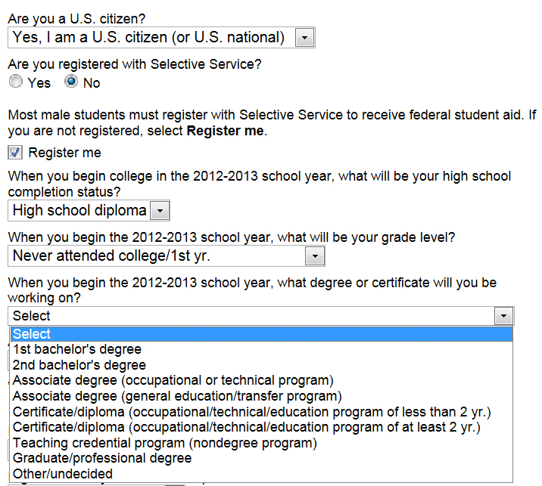
Section 1 - Degree or Certificate Objective
2013-2014
2013-2014
In the 2013-2014 school year, what degree or certificate will you, the student, be working on?
Some options are:
  1st bachelor’s degree
  Associate degree (occupational or technical program)
  Associate degree (general education or transfer program)
  Graduate or professional degree
Notes:
Degree or Certificate Objective:
The student should answer these questions for the school he or she is most likely to attend. The student should choose his/her most immediate degree objective even if he/she plans to seek an advanced degree (such as a law degree) at a later date.
For example, if the student is planning to attend a community college for an Associate degree in history leading to a transfer degree, he/she should select ” Associate degree (general education or transfer program).” If the student is planning to attend a 4-year college in 2013-2014, select “1st bachelor’s degree.”
If the student is unsure of the type of school he/she will attend, select the “1st bachelor’s degree.”

Slide 19

Section 1 - First Bachelor’s Degree
2013?
Will you have your first Bachelor’s degree before July 1, 2013?
students starting college in 2013-14 should mark “No” to this question
only students who will be pursuing a graduate or professional degree during 2013-14 should mark “Yes”
Notes:
First Bachelor’s Degree
This question asks students if they will have earned their first bachelor’s degree before July of 2013.
Students who have earned an undergraduate Bachelor’s degree are ineligible to receive federal and state grants, though they are still eligible for consideration for federal loans and work programs.
Only students who will be pursuing their graduate (e.g. Master’s or Ph.D.) or a professional degree (e.g. MD, Law or MBA) during 2013-14 should answer “Yes” to this question.

Slide 20
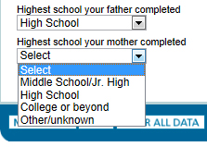
Section 1 - Parents’ Educational Level
Indicate highest level of schooling completed by the student’s biological or adoptive parents (for state award purposes only)
  Use birth parents or adoptive parents - not stepparents or foster parents
  This definition of parent is unique to these two questions
Notes:
Parents’ Educational Level
These questions are used for state scholarship purposes and do not affect eligibility for federal student aid. In California, these answers are used to determine Cal Grant B eligibility by measuring a student’s disadvantaged background.
Select the highest grade level completed by the student’s father and mother. Father and mother in these questions mean birth or adoptive parents, not legal guardians, stepparents, or foster parents. Note that this definition of parents is unique to these two questions.
In addition, some states and colleges use the answers to these questions to determine if the student is the first member of his or her family to attend college. This may make a difference in the type and amount of aid received because some schools offer additional aid to students who are the first in their family to go to college.
NOTE TO PRESENTERS: Discuss the difference between “completed” versus “attended.” For example, if the mother completed an AA degree at a community college, she would mark “High school” because she has not completed a four-year college degree program.
Also, if parents completed the equivalent of a bachelor’s degree or higher in a foreign country, they must select “College or beyond.”

Slide 21
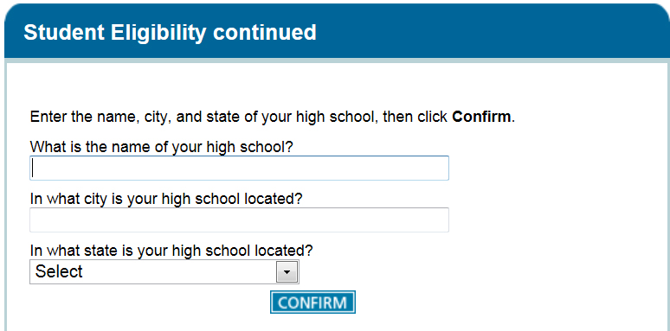
Section 1 - High School Question
High School Question
  Enter the name, city and state of the high school where the student received or will receive a high school diploma
  Select “Confirm” to retrieve the high school information
  If no matches are found, the student should select “Next” to save the search information and continue with the FOTW application
Notes:
High School Question
In this question, students will be asked to provide the name, city and state where they received, or will receive, their high school diploma. They will then be asked to confirm that their high school is on the list that is displayed on FOTW. If students do not find their high school name on the list, they should hit the “Next” button.
The U.S. Department of Education will share this information with the individual high schools attended by students who complete the FOTW.

Slide 22





Section 2 - School Selection
Strategies for Listing Colleges
FAFSA on the Web allows the student to list up to 10 colleges/universities that will receive his/her student and parent information
The student should list first the California school he/she is most likely to attend
The student may re-order his/her school choices
Then list other schools to which the student is applying for admission
List a California college or university first (for Cal Grant consideration)
Then list those schools with the earliest financial aid deadlines, regardless of whether they are in-state or out-of-state
If the student is applying to more than ten schools, wait for the processed Student Aid Report (SAR) and add additional schools via the Web or by phone using the student PIN
NOTE: Each UC and CSU campus must be listed separately
Notes:
Here are some tips for completing Section 2 — especially if the student is applying for financial aid at more than ten colleges or universities.
Students should make sure to list a California college or university first.
Then list the schools with the earliest financial aid deadlines, regardless of the state where the schools are located.
Students should make sure to include their first and second choice schools.
It’s important to keep in mind that the U.S. Department of Education's processor will send data to only ten schools at a time for a student.
Students applying to more than ten schools can add additional schools when they receive their processed Student Aid Report (SAR). We strongly recommend that students sending their financial aid information to a large number of schools use FAFSA on the Web and sign the form using PINs. This will make adding additional schools easier and faster.
If the student originally listed ten schools on the application and then replaced all ten with new schools by changing his/her SAR, only the second set of ten schools will get new data from any subsequent corrections made to the FAFSA data. In this case, the student should alert schools in the first group of any changes.
Financial aid is awarded by each individual college or university campus. Therefore, each UC and CSU campus to which the student is applying for financial aid must be listed separately in Section 2 of the FOTW.
For Cal Grant Entitlement purposes, if a student decides to attend a school that is not the first choice listed on the FAFSA, the student should contact the California Student Aid Commission. Later in the presentation, we will provide more information about managing your Cal Grant online.

Slide 23
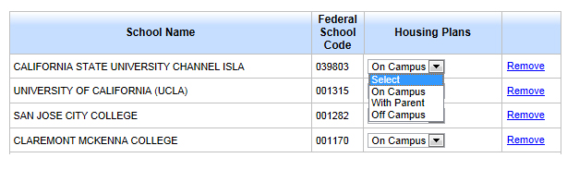
Section 2 - School Selection
The student will be asked to select the housing plan that best describes the type of housing the student expects to have while attending each listed school
The choices for housing are:
    On Campus
    With Parent
    Off Campus
The student’s choice of housing may affect the amount of financial aid for which he/she is eligible. It is usually more expensive to live on or off campus than with parents or relatives
Remember, selecting the On Campus housing option is not an application for On Campus housing. Check with the colleges/ universities for housing information when you apply for admission
Notes:
Next, students select the housing plan that best describes the type of housing they expect to have while attending each listed college or university. The student selects a planned living arrangement - “On campus,” “With parent,” or “Off campus” for each school listed. The student should list “On campus” if unsure whether he or she will live with parents.

Slide 24
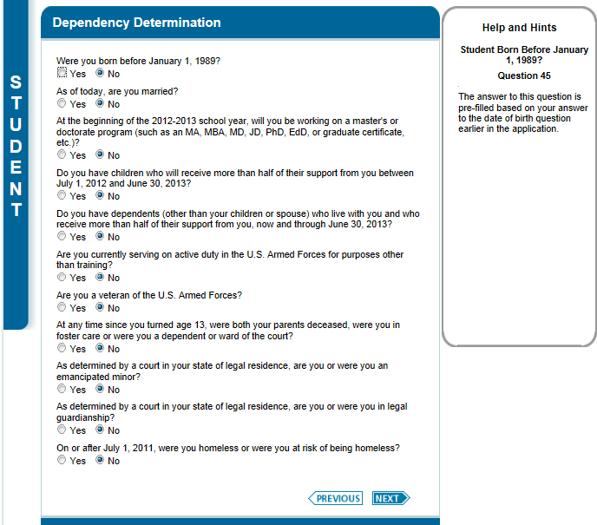

Section 3 - Determination of Student Dependency Status
1990?
2013-2014
2013
2014?
2014?
2012,
Notes:
NOTE TO PRESENTERS: At this point, read each of the dependency statements in Section 3 individually.
Homeless students are automatically considered to be independent. If you are working with any school homeless liaisons or homeless shelter staff, you should refer them to the National Association for the Education of Homeless Children and Youth web site
www.naehcy.org/dl/uy_fafsa_verif.doc
for a special form they may want to use to verify a student’s homeless status. Colleges and universities may also require such documentation.

Slide 25
Section 3 - Determination of Student Dependency Status
If the student checks “No” in all of the boxes about Dependency Status, the student will be asked to go to Section 4. For FAFSA filing purposes, the student is considered a dependent student and will be required to provide parental information
If any one of the items in this section applies to the student, he/she should mark the appropriate box, skip Section 4, and go to Section 5. The student is considered an independent student for FAFSA filing purposes and is NOT required to provide parental information
Notes:
Determination of Student Dependency Status
If none of the statements in this section fit the student’s circumstances, he/she is considered a dependent student and his/her parents will be required to provide information in the Parent Demographics and Financial Information sections.
If at least one of the statements matches the student’s circumstances, he/she will be considered independent and will be asked to provide information only for him/herself and for his/her spouse, if married.
NOTE: If the student has circumstances that make him/her believe that he/she is independent, then he/she may request special consideration from each college or university by submitting a letter of special circumstance directly to each financial aid office. Appeals are considered on a case-by-case and are decided by each individual college. Not all appeals will be granted.
For today’s purpose, we will assume that most students are required to provide parental information and so we will move on to the Parent Demographic section now.

Slide 26

Section 4 - Parent Demographics
Who is considered a parent?
  Biological or adoptive parent(s)
  In case of divorce or separation, provide information about the parent and/or stepparent the student lived with more in the last 12 months
  Stepparent (regardless of any prenuptial agreements)
Notes:
Who is Considered a Parent
Before starting this section, listen carefully to help determine who is considered a parent in this section. Students and their parents must answer all the questions in Section 4 as of the date they complete and submit the FOTW.
If the biological or adoptive parents are both living and married to each other, answer the questions about both of them.
If the parent is widowed or single (that is, never married), answer the questions about that parent.
If the widowed or divorced parent is remarried as of the day the FAFSA is submitted, answer the questions about that parent and the person to whom the parent is married (the student’s stepparent).
If the parents are divorced or separated, answer the questions about the parent the student lived with more during the past 12 months. If the student lived with both parents equally, submit financial data about the parent who provided the greater amount of support. If that parent is remarried, include stepparent information.
The term "parent" is not restricted to biological parents. There are instances (such as when a grandparent legally adopts the applicant) in which a person other than a biological parent is treated as a parent, and in these instances, the parental questions on the application must be answered, since they apply to such an individual (or individuals).
An adoptive parent is treated in the same manner as a biological parent on the FAFSA.
A stepparent is also treated in the same manner as a biological parent if the stepparent is married, as of the date of application, to the biological parent whose information will be reported on the FAFSA, or if the stepparent has legally adopted the student. There are no exceptions. Prenuptial agreements do not exempt the stepparent from providing required data on the FAFSA. The stepparent's income information for the entire base year 2012 must be reported even if the parent and stepparent were not married until after the start of 2012, but were married prior to the date the FAFSA was submitted.
.

Slide 27
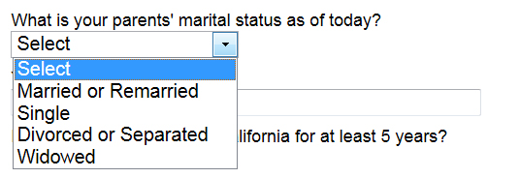
Section 4 – Parents’ Marital Status
Report your parents’ marital status as of today
  Married or remarried
  Single
  Divorced or separated
  Widowed
Depending on your parents’ answer to this question, they might be asked about the date of their marital status
Notes:
Parents’ Marital Status
Report your parents’ marital status as of today
Married or remarried
Single
Divorced or separated
Widowed
The student’s “parents “ for all the questions in this section and those that follow are the parents whose information will be provided on the FOTW and meet the definitions of parents we just covered in the previous two slides.
If your parents indicated that they are married or remarried, they will be asked the date of their current marriage.
If your parents indicated that they are divorced, separated or widowed, they will be asked the date of that status.

Slide 28
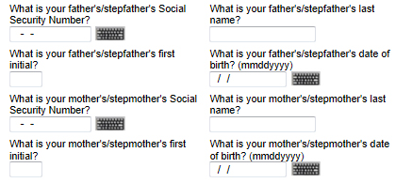
Section 4 - Parent Information
If the student is providing father’s/stepfather’s and/or mother’s/stepmother’s information, the student will need those parents’:
    Social Security Numbers
    Last names and first initials
    Dates of birth
Notes:
Parent Information
If the student is providing father’s/stepfather’s and/or mother’s/stepmother’s information, the student will need those parents’:
Social Security Numbers
Last names and first initials
Dates of Birth

Slide 29


Section 4 - Parent Household Size
2013-2014
Include in the parents’ household:
  the student
  parent(s)
  parents’ other dependent children, if
  the parents provide more than half their
  support or the children could answer “no” to every question in Section 3, regardless of where they live
  other people, if they now live with the parents and will continue to do so from 7/1/13 through 6/30/14, and if the parents provide more than half their support now, and will continue to provide support from 7/1/13 through 6/30/14
Notes:
Parent Household Size
The number of family members in the household directly affects the family’s ability to contribute to the student’s education costs.
The following persons should be included in the parents' household size in this question:
The student applicant should always be included, even if not currently living with parents
Parents (excluding a parent not living in the household as a result of death, separation, or divorce)
Parents' other children, if the parents will provide more than half of their support from July 1, 2013 through June 30, 2014, OR the children could answer "no" to all questions in Section 3 about their dependency (regardless of whether they live with the student’s parents)
Other people (aunts, uncles, grandparents, etc.) ONLY IF they now live with the student’s parents and will continue to do so from July 1, 2013 through June 30, 2014, AND the student’s parents provide more than one-half of their support now and will continue to provide more than half of their support from July 1, 2013 through June 30, 2014.

Slide 30

Section 4 - College Students in the Parent Household
2013
2014?
Always include the student even if he/she will attend college less than half-time in 2013-2014
Include other household members only if they will attend at least half-time in 2013-2014 in a program that leads to a college degree or certificate
Never include the parents in the number in college
NOTE: Some financial aid offices will require proof that other family members are attending college
Notes:
College Students in the Parent Household
This question asks for the number of household members in the previous question who, in 2013-14, will be enrolled in a college or university.
--Always include the student, even if he/she will be enrolled less than half-time
--Include others only if they’ll be attending at least half time in a program that leads to a degree or certificate at a college or university eligible to participate in any of the federal student aid programs
--Do not include parents
--Also do not include a student at a U.S. military academy because the family does not pay for his/her education (i.e., their entire education is paid for)
NOTE: The student’s parents cannot be included in the number of family members in college. However, if one or both of the custodial parents will be enrolled in college during the 2013-14 academic year, the family should be advised to contact the colleges to which the student is applying for admission and financial aid. The student should provide these colleges with written information about the reason why the parent is attending college and document the costs involved. The school may choose to recognize those additional family expenses in calculating the student’s eligibility for financial aid.

Slide 31

Section 5 - Parents’ 2012 Tax Return Filing Status
2012
The parents will be asked to provide information about their tax filing status for 2012:
  If parents have completed a 2012 federal income tax return, select “Already completed”
  If they have not as yet filed, but plan to file a 2012 federal income tax return, select “Will file”
  If they have not, nor will not, file a 2012 federal income tax return and are not required to do so, select “Not going to file”
Notes:
Parents’ Tax Return Filing Status
In this questions, parents will be asked to provide information about their tax filing status for 2012:
If the parents have completed a 2012 federal income tax return, the parents should select “Already completed”
If they have not as yet filed, but plan to file a 2012 federal income tax return, they should select “Will file”
If they have not, nor will not, file a 2012 federal income tax return and are not required to do so, they should select “Not going to file.”

Slide 32
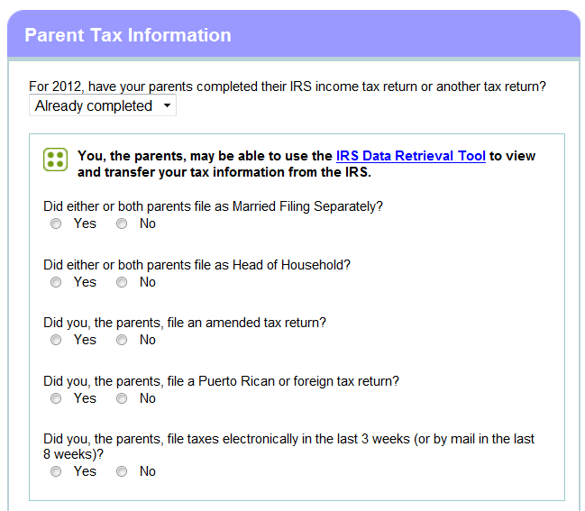
Section 5
IRS Data Retrieval
  This question asks if parents have completed their 2012 IRS income tax return
  If parent(s) answer “Already completed,” they will be given the option to transfer their 2012 income tax information directly from IRS records to the FOTW
  If parents indicate that they have recently filed their 2012 taxes, they may not be able to access their IRS data if they have filed taxes electronically within the last three weeks or by mail within the last eight weeks
  Instead, they should use their actual 2012 IRS tax return to complete the FOTW so the student does not miss any important financial aid deadlines
Notes:
IRS Data Retrieval
This question may allow some parents who have already completed their 2012 federal income tax return to transfer their tax data from the IRS directly to the U.S. Department of Education. Parents will be instructed how to do this in this section of the FOTW.
If parent(s) answer “Already completed”, they will be given the option to transfer their 2012 income tax information directly from IRS records.
If parents have filed their 2012 taxes electronically within the last three weeks ago or by mail less than eight weeks ago, they may not be able to access IRS data.
Some parents, regardless of when they filed their 2012 federal tax returns, will not be able to use this tool. These include those parents who:
are married and file separately;
file as Head of Household;
filed an amended federal tax return; or
filed a Puerto Rican or foreign tax return.
.

Slide 33

Section 5 – Parents’ 2012 Adjusted Gross Income
2012?
If the student’s parents have not yet filed their 2012 federal tax return, use estimated 2012 information for this question
The “Income Estimator” on the FOTW may help calculate this amount
If the student’s parents have completed their 2012 federal tax return, use actual 2012 tax return information to complete this item if they are not eligible to use the IRS Data Retrieval process
Notes:
Parents’ 2012 Adjusted Gross Income
The next question asks about parents’ 2012 adjusted gross income (AGI).
For parents who have not yet completed their 2012 federal tax return, the FOTW site provides an AGI Income Estimator which makes it easy to calculate an estimated AGI.
Remember, if custodial parents have not yet filed their 2012 federal tax return, it is fine to use estimated 2012 income information on the FOTW. There will be sufficient time to update this information when the parents complete their actual 2012 federal tax return.
If parents have completed their 2012 federal tax return, they should use actual 2012 tax return information to complete this item – either by using the IRS Data Retrieval process or their actual 2012 federal income tax return.
This question asks specifically about parents’ 2012 AGI. That is, the total of all taxable income they will list on their 2012 federal income tax form. This figure includes their wages as well as other taxable income such as interest and dividend income, business and rental property income, unemployment, as well as the taxable portion of pensions, IRA distributions, and Social Security benefits.

Slide 34
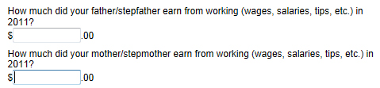





Section 5 - Money Earned from Work by Parent(s) in 2012
2012?
2012?
Use W-2 forms and other records to determine all income in 2012 earned from work (including business income earned from self-employment) for father/stepfather and/or mother/stepmother
Notes:
Money Earned from Work by Parents(s) in 2012
These next questions ask about custodial parent earnings from sources such as wages, salaries and tips. These questions must be answered whether or not the parents file a tax return. This information may be on their W-2 forms, or on IRS Form 1040, 1040A, or 1040EZ.
Parents who own a business or farm should report any income from these sources here as well so that Social Security taxes paid can be properly calculated.
It is important to list earnings correctly, because when the U.S. Department of Education calculates the parents' Expected Family Contribution (EFC), certain allowances are subtracted from the parents' income for required taxes and necessary expenses (such as income and Social Security taxes and basic living costs). The parents' income earned from work will also be used in the EFC calculation as an income factor when no tax form is filed.
Note to Presenters: FOTW asks separate questions about mother’s and/or father’s incomes from earnings. These questions are combined on the slide.

Slide 35
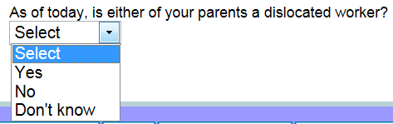
Section 5 - Parent Dislocated Worker
The student will be asked to check if the father/stepfather and/or mother/stepmother is a dislocated worker
A person may be considered a dislocated worker if he or she:
  is receiving unemployment benefits due to being laid off or losing a job and is unlikely to return to a previous occupation
  has been laid off or received a lay-off notice from a job
  was self-employed but is now unemployed due to economic conditions or natural disaster
  is a displaced homemaker
Notes:
Parent Dislocated Worker
The student will be asked if the father/stepfather and/or mother/stepmother is a dislocated worker.
A person may be considered a dislocated worker if he or she:
is receiving unemployment benefits due to being laid off or losing a job and is unlikely to return to a previous occupation, or
has been laid off or received a lay-off notice from a job, or
was self-employed but is now unemployed due to economic conditions or natural disaster, or
is a displaced homemaker.
A displaced homemaker is generally a person who previously provided unpaid services to the family, for example:
a stay-at-home mom or dad who is
no longer supported by the husband or wife; and
is unemployed; and
is having trouble finding or upgrading employment.
These definitions will be available on FOTW, so don’t worry about remembering all this information.

Slide 36
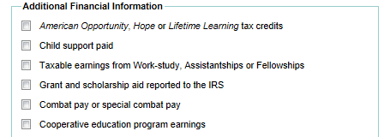
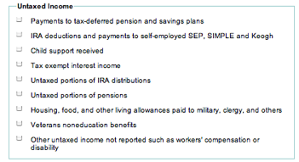
Section 5 - 2012 Additional and Untaxed Financial Information
Notes:
2012 Additional Financial Information
This Additional Financial Information question asks about information not considered as part of parental income when calculating student need. For example, if either of the custodial parents is paying child support for a child in another household, this amount will be subtracted from the total custodial parent income.
The student should check all that apply. Online at FAFSA on the Web, the student may be asked to report his or her parents’ annual 2012 amounts for all boxes checked.

Slide 37
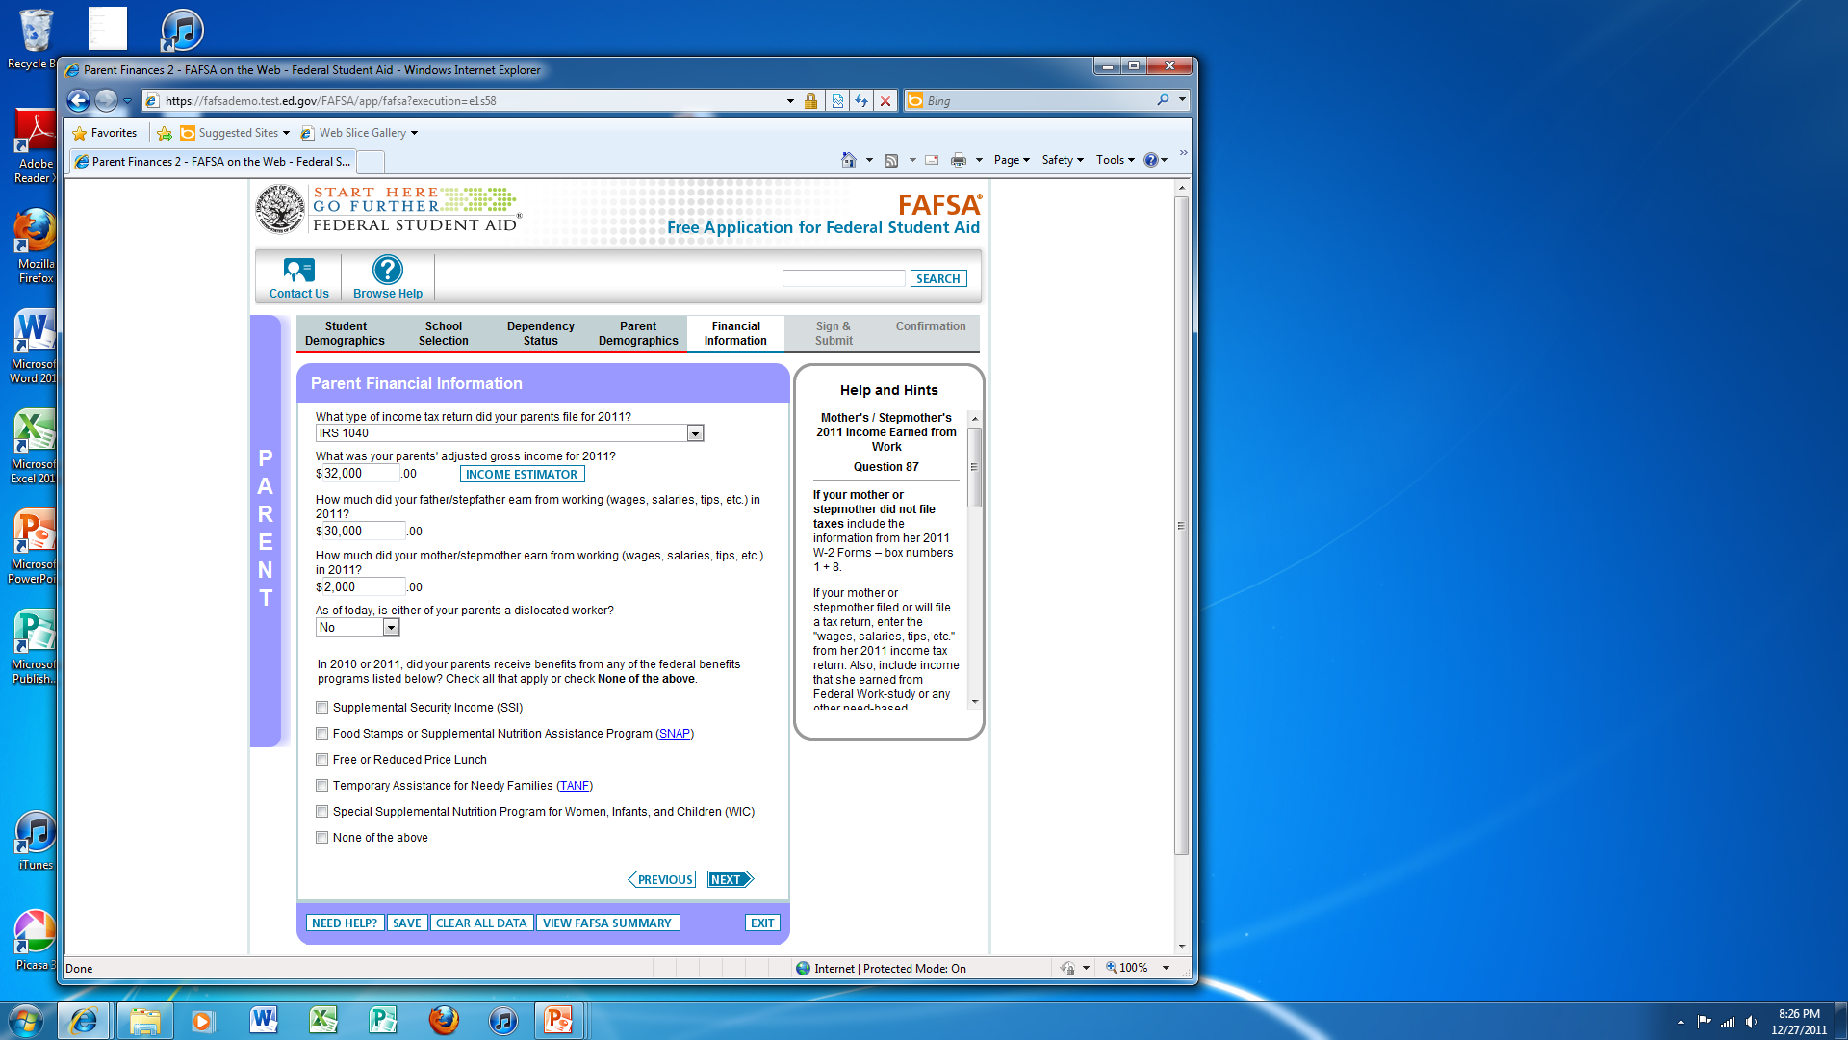
Section 5 - Parents’ Household 2011 or 2012 Benefits Received
2011 or 2012
Indicate if the student, his/her parents, or anyone in the parents’ household received benefits in 2011 or 2012 from any of the federal programs listed
Supplemental Security Income (SSI)
Supplemental Nutrition Assistance Programs (SNAP)
Free or Reduced Price School Lunch
Temporary Assistance for Needy Families (TANF)
Special Supplemental Nutrition Program for Women, Infants and Children (WIC)
Notes:
Parents’ Household 2011 or 2012 Benefits Received
Receiving benefits from one of the federal programs listed on the FAFSA affects the way the U.S. Department of Education calculates the parent expected family contribution, or EFC.
If the student, the student’s parents, or a member of the parents’ household received benefits from one of the following federal programs in 2011 or 2012, mark all that apply:
Supplemental Security Income (SSI)
Supplemental Nutrition Assistance Programs (SNAP) (formerly Food Stamps)
Free or Reduced Price Lunch
Temporary Assistance to Needy Families (TANF)
Special Supplemental Nutrition Program for Women, Infants, and Children (WIC)
None of the above

Slide 38

Section 5 – Parent Assets
Some parents may be asked to report the current balances of their cash, savings, and checking accounts as of the day they complete the FAFSA
They may also be asked to provide information about the net value of their investments such as real estate, rental property, money market and mutual funds, stocks, bonds and other securities
In addition, they may be asked questions about the net value of their businesses and investment farms
They should not include the home in which they live, the value of life insurance and retirement plans, or the value of a family-owned and controlled small business
Notes:
Parent Assets
Some parents may be asked to provide information about their assets depending on their level of income.
An asset is defined as property that has an exchange value. The purpose of collecting asset information is to determine if the family’s assets are substantial enough to support a contribution toward the student’s educational expenses.
Assets fall into three categories for the FAFSA on the Web. These are:
Cash, savings and checking
Investments
Business or Investment farm value
Cash, savings and checking are liquid funds that parents have as of the day the student and his or her family complete the FAFSA.
Investments include some of the following: real estate (other than the parents’ primary home), trust funds, UGMA and UTMA accounts, money market and mutual funds, certificates of deposit, stock and stock options, bonds and other securities, Coverdell Education IRAs, college savings plans including 529(c) plans owned by parents, installment and land sale contracts, and commodities.
Business and investments farms include the market value of land, buildings, machinery, equipment, and inventory. Debt means only those debts for which the business/investment farm was used as collateral.
Keep in mind that only the net worth (the current value minus debt) of assets should be reported.
Remember, parents should not report assets such as the family home, the value of any life insurance, or the value of a family-owned and controlled small business . (A small business is defined as one with 100 or fewer full-time or full-time equivalent employees). And, most importantly, any accumulated funds in retirement accounts such as Roth or traditional IRAs, pension funds, Keogh, 401K, 403B, or other plans should not be reported.

Slide 39
Section 5
Student Financial Information
Student questions in Section 5 are identical to the parent financial questions we covered
  If the student is married, also report spouse’s income and assets
The questions in Section 5 ask:
  Which 2012 federal tax return the student filed or will file
  The student’s 2012 Adjusted Gross Income, if filing a tax return, and earnings from work as well as untaxed income and assets
Notes:
Student Financial Information
The student questions in Section 5 concerning student finances are identical to those for the parents we have already covered. We will not review the student income information in this section in any detail.
If the student is married at the time the FOTW is submitted, the spouse’s 2012 income and current value of combined student and spousal assets must be included, even if the student was not married in 2012.
How many students here today are considered independent for purposes of completing the FOTW?
NOTE TO PRESENTERS: Based on the number of participants in the audience who respond affirmatively to being independent, either have the students see you after the formal presentation or review Slides 67-71 at this point.

Slide 40
What Happens Next?
Students and the colleges the student listed receive Student Aid Report (SAR) from federal processor
ê
Students who complete FAFSA and Cal Grant GPA Verification Form receive California Aid Report (CAR)
ê
Students and families review SAR and CAR for important information and accuracy of data
ê
Colleges match admission records with FAFSA and other required financial aid forms to determine aid eligibility
ê
Colleges provide notices of financial aid eligibility to admitted students who have completed all required financial aid forms
Notes:
What Happens Next
Shortly after completing the FOTW, the student should receive a Student Aid Report (SAR) from the federal processor. The SAR summarizes the information the family provided on the FAFSA. Each school listed on the SAR will also receive the information electronically. If the student does not receive the SAR within two weeks, he/she should contact the federal processor to check on the status of the FAFSA. Call 1-800-4-FED AID (that’s 1-800-433-3243) or check on the status of your FAFSA by going to FAFSA.gov using the student PIN.
When the California Student Aid Commission evaluates the student’s FAFSA and Cal Grant GPA Verification Form, the student will receive a California Aid Report (CAR) that will provide the student with information about his/her Cal Grant eligibility.
Once each school receives the electronic SAR and all other required financial aid forms, and confirms the student’s admission status, the financial aid office will determine the student’s financial aid eligibility. Some schools may request that the student submit income documentation such as student and parent 2012 federal income tax returns (including W-2s and all schedules and attachments) or 2012 Federal IRS Tax Transcripts, before sending the student a final determination of eligibility. The school will use these and any other requested information to verify the accuracy of the data provided on the FAFSA. Schools understand that many families have used estimated data.
A financial aid notification (commonly referred to as an award letter) describing the amounts and sources of aid the student has been awarded will be prepared for the student when the student’s financial aid application is complete. Most schools will wait until the student has been accepted for admission to notify him or her about financial aid eligibility. Some schools will mail a paper notification to the student; others may provide the it electronically.
In some cases, the student will be required to sign and return a copy of the financial aid notification, indicating whether he/she accepts or declines each source of aid.
If family circumstances change after the student completes the FAFSA and other required financial aid documents, make sure to contact the financial aid office at each school as soon as possible.

Slide 41
Federal Verification
Some students may be required to verify the information reported on the FAFSA
If selected for verification, the tax information of federal tax filers will be verified through
  The IRS Date Retrieval Process, or
  IRS Tax transcripts if requested by the college or university
Non-tax filers selected for verification may be asked to provide
  Signed statements confirming that they did not file a 2012 federal tax return and were not required by IRS to do so
  Copies of W-2s or other income documentation from each employer , if any income was earned from work
All selected aid applicants will also be asked to verify certain demographic data listed such as
  Household size and number in college
  Child Support paid and SNAP, if reported on the FAFSA
Notes:
Federal Verification
In order to assure that information provided by students and parents is accurate, the U.S. Department of Education requires colleges and universities to verify the accuracy of financial and other demographic information provided on the FAFSA. Verification of FAFSA data helps colleges and universities accurately and equitably determine the types and amounts of federal funding students will receive.
If selected for verification, the tax information of federal tax filers will be verified through
The IRS Data Retrieval Process, or
IRS Tax Transcripts if requested by the college or university
Non-Tax filers selected for verification may be asked to provide
Signed statements confirming that they did not file a 2012 federal tax return and were not required by IRS to do so; and
Copies of W-2s or other documentation from each employer, if any income was earned from work.
All selected aid applicants will also be asked to verify certain demographic data listed such as
Household size and number in college,
Child Support paid and SNAP, if reported on the FAFSA
Some colleges and universities may require the verification of additional information for determining eligibility for state and their own student aid funds.

Slide 42
Check Your Cal Grant
By opening a WebGrants Account a student can:
Check Cal Grant award status 24/7
Confirm student’s high school graduation as required
Make changes to Cal Grant school choices
View how much a Cal Grant is worth at different California colleges and universities
View Cal Grant payment history
Create a WebGrants account at: www.webgrants4students.org
Notes:
Check Your Cal Grant
Students are encouraged to open a WebGrants account to manage their Cal Grant. After doing so, they can
- Check their Cal Grant application and award status 24/7
- Confirm their high school graduation as is required to receive Cal Grant payment
- Make changes to their Cal Grant school choices
- View how much their Cal Grant may be worth at different California colleges and universities as well as
- View their Cal Grant payment history
In addition, they can click on links to other financial aid information and web sites.
Students can create a WebGrants account at: webgrants4students.org

Slide 43

Q & A
Q & A
Q
&
A
Q
&
A
Q
&
A
Q
&
A
?
Q & A
Q & A
Notes:
Questions and Answers
We hope you have found this workshop helpful.
We will now be glad to answer any general questions you and your family might have.
After a brief question and answer period, volunteers will be available to help you complete the 2013-14 FAFSA on the Web, the 2013-14 Cal Grant GPA Verification Forms, and answer any questions about other financial aid documents.

