Slide 1


Applying for Financial Aid
2015-2016
Notes:
Thank you for coming to our California Cash for College workshop.
Today, we will be discussing how to apply for college financial aid for the
2015-16 academic year.

Slide 2
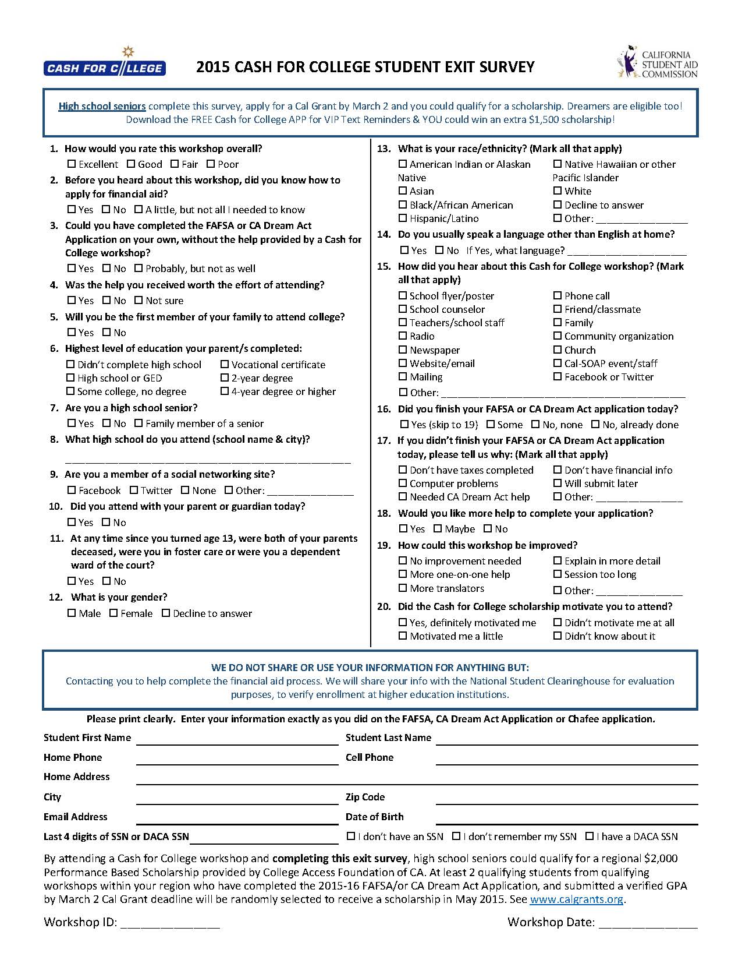
Cash for College $2,000 Scholarship
Evaluation
4 scholarships for East Bay Region
Students must complete and turn in the Student Evaluation BEFORE you leave!
CFC workshops should be using online program
If paper submitted, students should write Clearly!
Must submit your FAFSA/DREAM Act and
Cal Grant GPA by March 2nd
Winner will be chosen after March 2nd and announced by your counselor or by a letter mailed to the address provided.
Scholarship will be sent to the college.

Slide 3
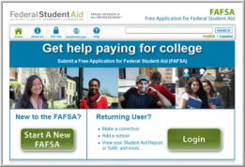

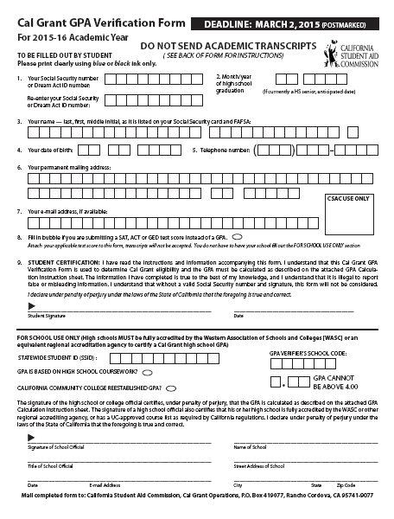
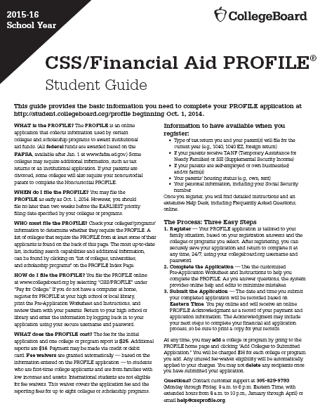
Types of Applications
FAFSA
Undocumented students covered under AB540 or DACA should complete the California Dream Act Application
Cal Grant GPA Verification Form
Other applications or forms as required by the college such as:
CSS/Financial Aid PROFILE
    Institutional Scholarship and/or Financial Aid Application
  2014 federal tax returns (along with all schedules and W-2s) or other income documentation
Notes:
Types of Applications
There are a number of important financial aid forms:
-The Free Application for Federal Student Aid (FAFSA) is required by all colleges and universities for the awarding of federal and state aid. Every student should complete the FAFSA. In some instances, a school may use the FAFSA for institutional aid as well. The FAFSA should be completed by students and their families in electronic format (FAFSA on the Web). We will discuss the FAFSA on the Web in greater detail in just a few minutes
- Undocumented students covered under AB540 or DACA should complete the California Dream Act Application.
- As previously mentioned, in order to be considered for a Cal Grant, students must also complete the Cal Grant GPA Verification Form. This form must be certified by their high school and submitted to the California Student Aid Commission (CSAC) by March 2, 2015.
-The CSS/Financial Aid PROFILE is used by many private or independent colleges and universities as well as a few public universities outside of California to determine eligibility for their own funds. Some scholarship competitions may also require the CSS PROFILE.
- Some colleges or universities may require their own scholarship or financial aid applications in addition to the FAFSA. The additional forms, such as those for the Community College Board of Governors (BOG) Fee Waiver, may collect information not requested on the FAFSA. These forms help the institution award its own funds and must be returned to the college or university directly.
- As noted earlier, many employers, organizations, and community-based agencies offering scholarships require students to complete separate applications.
- Many colleges will request copies of student and parent 2014 federal tax returns and other income documentation. We suggest the student and parents complete their 2014 federal income tax forms as soon as possible. Make sure to keep copies of these forms along with all schedules and W-2’s.
- Also, be sure to submit any required applications or requested documents by the published deadlines. At many institutions, failure to meet a deadline may jeopardize student eligibility for grants and other types of aid. We cannot emphasize this enough – don’t miss out on financial aid or college opportunities by missing a deadline.

Slide 4

Types of Financial Aid
Gift Aid - Grants or scholarships that do not need to be earned or repaid
Work - Money earned by the student as payment for a job on or off campus
Loans - Borrowed money to be paid back, usually with interest
Notes:
Types of Financial Aid
There are three major types of financial aid – grants and scholarships, work-study, and educational loans.
Grants and scholarships are gift aid that does not need to be earned or require repayment. Grants are usually based on the student’s financial need. Scholarships are generally based on talent and/or merit.
While there are a number of grants and scholarships available to California students, the Cal Grant program is one of the most widely available. Cal Grants are an example of gift aid based on need and merit. We will discuss Cal Grants in more detail later in the presentation.
Work programs provide opportunities for students to earn money to help pay for school expenses.
Both students and parents can borrow from a variety of low interest educational loan programs designed to help with the educational expenses of the student. Student loans usually do not require repayment until the student is no longer in school. Parent loans may require payment while the student is still in school.

Slide 5

Sources of Financial Aid
Federal government
State government
Colleges and universities
Private agencies, companies, foundations, and employers
Notes:
Sources of Financial Aid
By completing the financial aid applications and any other documents required by the colleges and universities to which the students are applying, they may be considered for funds from:
- the federal government;
- the state government; as well as
- colleges and universities themselves.
Private agencies, companies, foundations, and maybe even the students’ and parents’ employers provide scholarships for college. Though important, these sources provide less than 6% of the total financial aid awarded to students. Check with each of the private agencies, companies, and foundations to which the students wish to apply about application forms and deadlines. Web sites such as www.studentscholarshipsearch.com, www.fastweb.com and www.finaid.org are good resources for such scholarships.

Slide 6

How Does Financial Aid Work?
  Colleges determine and offer their students financial aid based on the following equation.
  Also known as “Need Analysis.”
Cost of Attendance (COA)
Expected Family Contribution (EFC)
Financial NEED (Financial Aid Eligibility)

Slide 7
Cal Grants
Cal Grant A Entitlement Awards – for high school seniors and recent high school grads
  with a Grade Point Average (GPA) of at least 3.0
  family income and assets below the state ceilings
  who demonstrate financial need
Cal Grant B Entitlement Awards – for high school seniors and recent high school grads
  with a GPA of at least 2.0
  who come from disadvantaged or low income families
  whose family income and assets are below the state ceilings
  who demonstrate financial need
Cal Grant C Awards - for students from low income families pursuing vocational programs of study
Notes:
Cal Grants
Let’s talk about Cal Grants – an important source of grant funds provided by the State of California for California students. Students planning to attend a California college or university may be eligible to receive one of the following Cal Grants. High school Grade Point Average (usually referred to as the GPA) is an important eligibility criterion for these grants. The Cal Grant GPA is calculated using grades from sophomore and junior years of high school and any summer grades after each of those years. Awarded grants may be renewed if students and their families continue to meet all eligibility requirements.
Please note: for purposes of the Cal Grant A and B Entitlement Awards, a “recent high school graduate” is defined as a student who is applying for a Cal Grant within 18 months of high school graduation.
Cal Grant A - To be eligible, students need a minimum 3.0 GPA - that is a B average on a 4.0 scale. Their families must have income and assets that are lower than the state-established ceilings and must demonstrate financial need of at least $1,500 at the college they plan to attend. This grant currently covers system-wide fees at the California State University and University of California campuses and up to $9,084 of tuition and fees at independent California colleges and universities.
Cal Grant B - This grant is for students who have a minimum 2.0 GPA - that is a C average. The students must come from low income disadvantaged families, meet state income and asset ceilings and demonstrate financial need of at least $700. This grant provides a small stipend of about $1,648 per year for up to four years to help with living expenses at all schools. In addition, the grant covers system-wide fees at California public 4-year institutions and up to $9,084 of tuition and fees at independent 4-year California schools. Students attending for-profit career colleges currently receive grants between $4,000 and $9,084 per year. In most cases, the tuition and fee portion of the Cal Grant B is available to students in their 2nd through 4th years only.
Cal Grant C - This grant is for students from low income families attending occupational or vocational schools including community college programs of less than 24 months in length. The Cal Grant C may renewable for one additional year if student and family continue to meet state-established income and asset ceilings.
Priority for Cal Grant C is now given based on Occupational Goals that meet two of the following:
high employment need;
high employment growth; and
high wages.
.

Slide 8

Eligibility for Cal Grants
To be eligible for a Cal Grant, the student must also:
  be a U.S. citizen, eligible noncitizen, AB540 student -
  including AB540 eligible DACA st students
  be a California resident
  attend an eligible, accredited California college or university at least half-time in 2015-2016
Notes:
Additional Cal Grant Requirements
To be eligible for a Cal Grant, the student must also:
be a U.S. citizen or eligible noncitizen as defined in the Free Application for Federal Student Aid (FAFSA). If a student qualifies under AB540, he/she may qualify for Cal Grant funding. This includes Deferred Action Childhood Arrivals (DACA) who are AB540 eligible.
(We’ll talk more about what this means later in the session as well as which application the students should complete);
be a California resident; and
attend an accredited California college or university at least half-time in the 2015-2016 academic year and each subsequent term the student is enrolled.

Slide 9



2015-2016 Cal Grant
Application Requirements
By March 2, 2015, complete and submit:
Free Application for Federal Student Aid (FAFSA)
Cal Grant GPA Verification Form
If eligible under AB540 or DACA, students should complete the
California Dream Act Application: www.caldreamact.org
Check with your high school or college counselor for more details on how to file the
Cal Grant GPA Verification Form, required of all students
Notes:
Cal Grant Application Requirements
In order for a student to be considered for a first-time 2015-2016 Cal Grant, the California Student Aid Commission (CSAC) requires that he/she submit both the Free Application for Federal Student Aid and the Cal Grant GPA Verification Form by March 2, 2015. We encourage all applicants for federal and state aid to file as soon as possible after January 1, 2015.
Students who may be eligible for Cal Grants under AB540 should complete the California Dream Act application at www.caldreamact.org instead of the FAFSA. This includes AB540 eligible DACA students. The Cal Grant GPA Verification Form is also required.
Students with a Deferred Action Childhood Arrivals (DACA) status who are not AB540 eligible should also complete the California Dream Act Application. They should also check with the colleges and universities to which they apply to see if they should alomplete any other forms.the Free Application for Federal Student Aid (FAFSA or other forms), but should complete the California Dream Act Application first.
Most high schools submit student grade point averages directly to CSAC on behalf of their students. Others require that students complete the student section of the Cal Grant GPA Verification Form. (The student section of the form asks simple information such as the student’s name, address and Social Security Number). If the paper form is required, it is important to submit it as soon as possible to the high school counselor or registrar because it may take a few days to certify the student’s grade point average. The student can download a Cal Grant GPA Verification Form at: www.calgrants.org. The GPA Verification Form must be postmarked no later than March 2, 2015.
Check with the student’s high school Counseling Office/Guidance Center to see if he/she needs to submit the paper Cal Grant GPA Verification Form or if the high school will submit the GPA electronically on the student’s behalf. If the high school submits the Cal Grant GPA Verification Form electronically, the student may have to authorize the release of his/her Social Security Number.
We urge students to file these forms as soon as possible. Don’t wait for the March 2nd deadline and miss out on a valuable grant that, like other grants, does not have to be repaid.
Students who have qualified and received a Cal Grant for the previous school year should complete the 2015-2016 FAFSA as soon as possible after January 1, 2015 and check with the financial aid office at the school they will attend for any other requirements. The GPA Verification Form is not required.

Slide 10

Middle Class Scholarship
Undergraduates with family incomes of up to $150,000 who:
  Submit 2015-16 Free Application for Federal Student Aid (FAFSA) by March 2, 2015
  attend a UC or CSU
  are U.S. citizens, permanent residents, or have AB540 status
  are California residents, and
  maintain a 2.0 cumulative GPA
Annual award amounts:
  To be determined by the California Student Aid Commission
Notes:
The Middle Class Scholarship
The Middle Class Scholarship (MCS) is designed to assist California residents who are new and continuing UC and CSU undergraduate students with family incomes up to $150,000.
To apply for the MCS for 2015-16, students must submit, by March 2, 2015, the:
- 2015-16 FAFSA
- For AB540 students, the 2015-16 California Dream Act Application. This includes AB540 eligible DACA students
MCS awards vary based on the number of eligible students, the institution, and state funding allocated. In 2015-16, maximum awards will range up to $2,438.
Amounts are determined after Federal Pell Grants, Cal Grants and institutional grants are awarded. Students cannot receive both federal and/or state grant aid and the MCS.
Qualifying students will be notified by the California Student Aid Commission. The Commission will also determine the maximum awards.
For renewal, student must maintain a cumulative 2.0 GPA, continue to meet all eligibility requirements including completing the FAFSA or the California Dream Act application by the appropriate deadlines.

Slide 11

California Chafee Grant
The California Chafee Grant program provides up to $5,000 annually to current and former foster youth for college or vocational training at any accredited college in the U.S., based on available funding
To be eligible, foster youth must have been in California foster care on their 16th birthday and not have reached their 22nd birthday before
July 1, 2015
Foster youth are encouraged to apply during their senior year of high school
To apply, the foster youth must complete:
  2015-2016 FAFSA
  California Chafee Grant Program Application
  AB540 students may also be eligible
To apply for a
Chafee Grant, go to: www.chafee.csac.ca.gov
Notes:
Chaffee Grant
If the student is a current or former foster youth, the California Chafee Grant may provide some additional financial aid for college. If you are the foster parent or know a foster youth, tell him/her about this special program for foster children.
The California Chafee Grant program provides up to $5,000 annually to current and former foster youth for college or vocational training at any accredited college in the U.S. The continued availability of this grant is dependent on available funding.
To be eligible, foster youth must have been in California foster care on their 16th birthday and may not have reached their 22nd birthday before July 1, 2015.
Students are encouraged to apply during their senior year of high school.
To apply, the foster youth must complete:
- 2015-16 FAFSA
- AB540 students should complete the California Dream Act Application.in place of the FAFSA. This includes AB540 eligible DACA students
- California Chafee Grant Program Application
To learn more about the Chafee Grant, go to
www.chafee.csac.ca.gov

Slide 12
Undocumented Students
If the student is undocumented
and is applying to any California public college or university, check to see if he/she might be eligible for in-state tuition/fee costs (AB540)
visit www.CalDreamAct.org to learn more about the new California Dream Act signed into law in 2011
check with colleges and universities about CA Dream Act institutional financial aid and private scholarships and the timelines for applying
apply for all other private scholarships for which the student may be eligible
start inquiring in elementary, middle or high school to see if it is possible for younger students to become permanent residents
  For more information and a list of scholarships, go to
  www.latinocollegedollars.org
  www.finaid.org/otheraid/undocumented.phtml
  www.e4fc.org
Notes:
12
If the student is undocumented, he/she may qualify for in-state tuition/fee costs through state law (AB 540). The California Dream Act (AB 130 and 131) provides state financial aid and access to private scholarships administered by public college s and universities.
Learn more about the Dream Act, go to the California Student Aid Commissions website at www.caldreamact.org.
AB 130 – Part 1 CA Dream Act
Signed into law on July 25, 2011
Becomes effective January 1, 2012
Allows students who meet AB 540 criteria to apply for & receive non state-funded scholarships at the public colleges and universities, including scholarships funded through private donors, alumni contributions, or individual departmental efforts
For information about how and when to apply, AB 540 students must contact their financial aid offices
AB 131 – Part 2 CA Dream Act
Signed into law on October 8, 2011
Becomes effective January 1, 2013
Allows students who meet AB 540 criteria to
Apply for & receive institutional grants like UC Grant, State University Grant, Educational Opportunity Program and Educational Opportunity Program & Services fee waivers
Apply for & receive Board of Governors fee waivers at the California Community Colleges
Apply for & receive state financial aid, including Cal Grants and Chafee Foster Youth Grant for use at eligible institutions
Cal Grant online application (Dream App) will be activated January 1, 2013 to gather financial & other information
Dream Act Cal Grants may be first used in the 2013-2014 school year
Dream applicants must meet all other Cal Grant requirements
For information about how and when to apply for institutional grants and fee waivers, AB 540 students must contact their financial aid offices
Students should also:
apply for all private scholarships for which they may be eligible
For a list of scholarships for undocumented students, go to:
www.latinocollegedollars.org
or
www.finaid.org/otheraid/undocumented.phtml
Watch for changes in federal and state laws regarding the eligibility of undocumented students.
If parents have younger children, they should start inquiring in elementary, middle or high school to see if it is possible for the students to become permanent residents.
For more information, contact the Mexican American Legal Defense and Education Fund (MALDEF): call (213) 629-2512

Slide 13
Assembly Bill (AB) 540 (Firebaugh, 2001)
Notes:
Assembly Bill 540 (Firebaugh, 2001) created the first state authorized benefit for undocumented students

Slide 14


Slide 15

FAFSA on the Web (FOTW)
Internet application used by students and parents to complete electronic FAFSA at:
www.fafsa.ed.gov
Sophisticated online edits checks and skip logic help avoid errors
Online help is available for each question
Student and one custodial parent should get a federal PIN to sign FAFSA at:
www.pin.ed.gov
Notes:
FAFSA on the Web (FOTW)
The primary benefit of using FAFSA on the Web (FOTW) is that the processing time is significantly reduced. Students and schools receive a response from the federal processor more quickly, which in turn assists schools in preparing a more timely notification of eligibility for financial aid. (This is a definite advantage if the student is trying to decide between two or more schools.)
Other benefits are:
- Fewer errors on the form. Built-in edit checks will not allow the family to go to the next section if something is left incomplete in a prior section. Before submitting the FOTW, the program will do a final review of the entire application, checking for missing and/or conflicting information.
- Thanks to skip-logic, there are fewer questions to complete. This means that the student will not be asked questions that do not apply. (Example: unmarried students will not be asked questions about a spouse.)
- In many cases, drop down boxes are provided so the family can choose from a selection of responses.
- Families who have submitted their 2014 federal income tax returns may be able to transfer IRS data directly to the FOTW.
- As soon as the FOTW is submitted, a Confirmation page can be printed to instantly verify that the application has been submitted. This page will contain a Confirmation Stamp showing the date and time that the FOTW was successfully submitted.
To take full advantage of the FAFSA on the Web, remember that both the student and one of his or her custodial parents must have a federal PIN to electronically sign the FOTW.
NOTE: For the remainder of this presentation, the terms FAFSA and FAFSA on the Web (FOTW) will be used interchangeably.

Slide 16
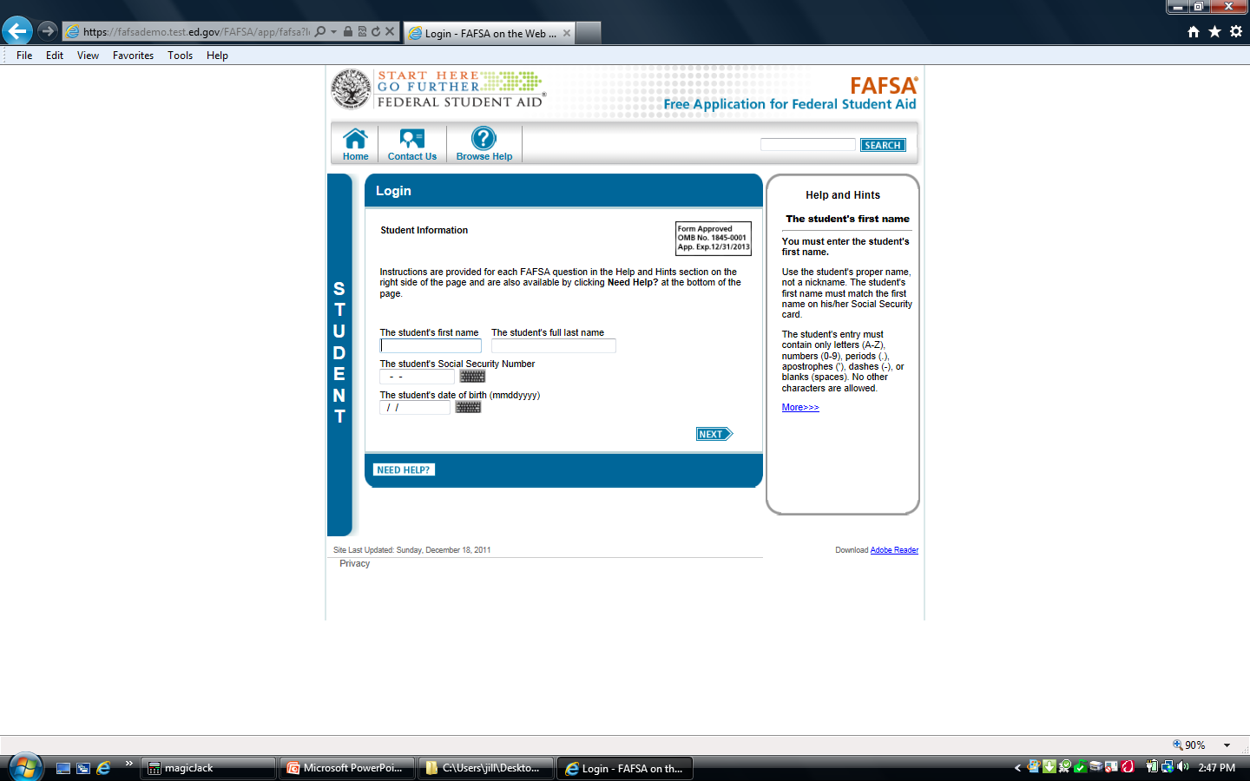
Login
The FOTW will ask for the student’s first and last names
Make sure to report the student’s name exactly as it appears on the student’s Social Security card
Notes:
Student Name
It is important to list the student’s name exactly as it is shown on the student’s Social Security card. The FOTW will ask for the student’s first and last name. For example: report Susan Jones, not Suzie Jones, if Susan is the student’s first name on the Social Security card.

Slide 17
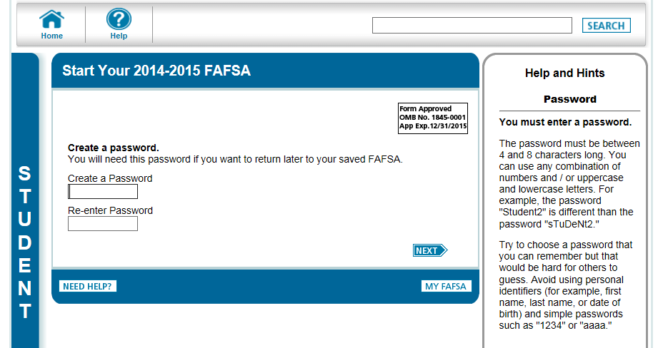
Create a Password
Start Your 2015-2016 FAFSA
Form Approved
OMB No. 1845-0001
App Exp. 12/31/2016
Form Approved
OMB No. 1845-0001
App Exp. 12/31/2016
Notes:
Create a Password
Creating a Password for the FAFSA is important because it will be needed if the student wants to return to the FAFSA to make changes/corrections or if he/she was not able to complete the FAFSA in one sitting.

Slide 18
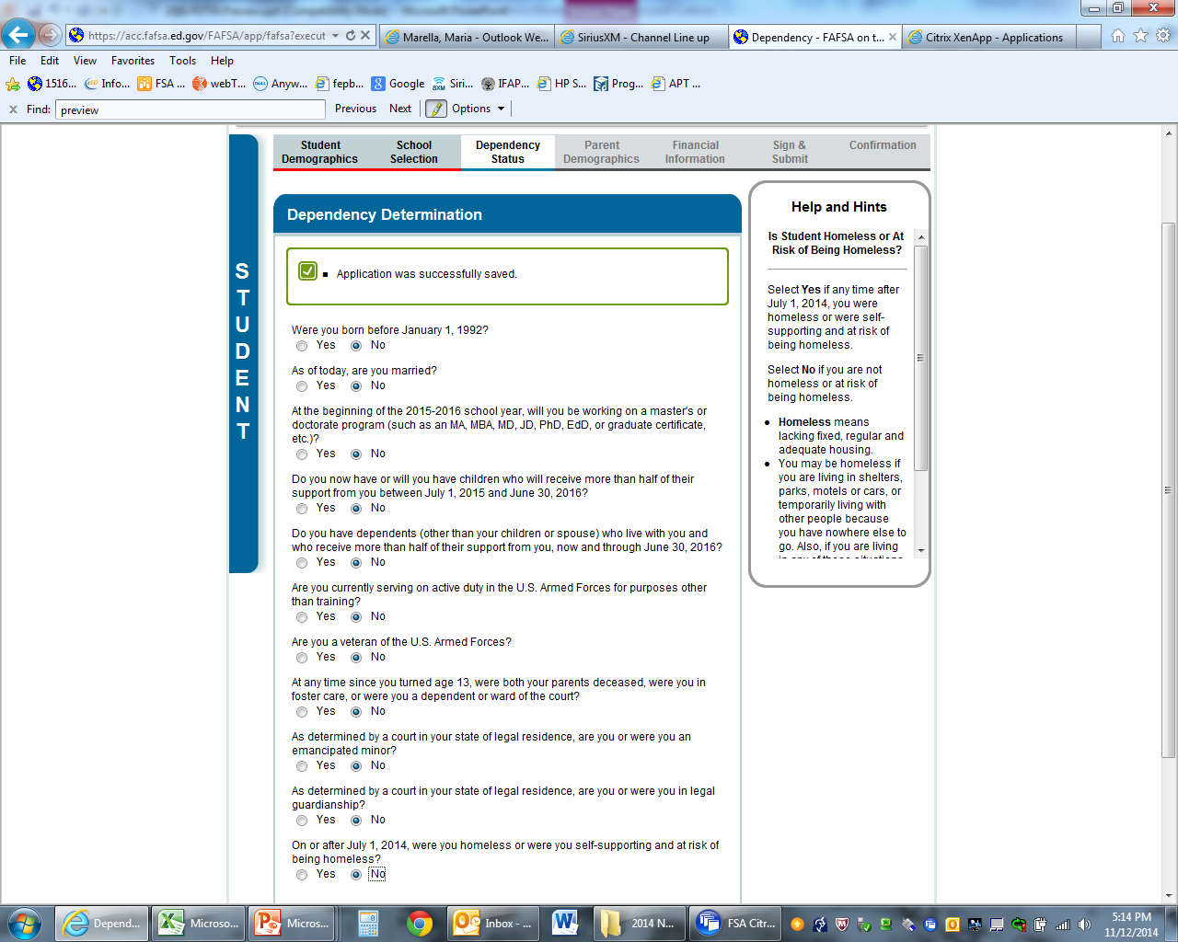
Section 3 - Determination of Student Dependency Status
Notes:
18
NOTE TO PRESENTERS: At this point, read each of the dependency statements in Section 3 individually.
Homeless students are automatically considered to be independent. If you are working with any school homeless liaisons or homeless shelter staff, you should refer them to the National Association for the Education of Homeless Children and Youth web site
www.naehcy.org/dl/uy_fafsa_verif.doc
for a special form they may want to use to verify a student’s homeless status. Colleges and universities may also require such documentation.

Slide 19

Section 4
Parent Demographics
Who is considered a parent?
  Biological or adoptive parent(s)
    Including same-sex parents
    Including unmarried parents living together
  In case of divorced or separated parents who don’t live together, provide information about the parent the student lived with more in the last 12 months
  Stepparent (regardless of any prenuptial agreements), if currently married to the student’s custodial parent
Notes:
Who is Considered a Parent
Before starting this section, listen carefully to help determine who is considered a parent in this section. Students and their parents must answer all the questions in Section 4 as of the date they complete and submit the FOTW. These instructions apply even if you do not live with your legal parents but are still required to provide parental information on your 2015-2016 FAFSA.
- If the biological or adoptive parents are both living and married to each other, answer the questions about both of them. This includes same-sex parents and all unmarried parents living in the same household.
- If the parent is widowed or single (that is, never married), answer the questions about that parent.
If the widowed or divorced parent is remarried as of the day the FAFSA is submitted, answer the questions about that parent and the person to whom the parent is married (the student’s stepparent).
- If the parents are divorced or separated, answer the questions about the parent the student lived with more during the past 12 months. If the student lived with both parents equally, submit financial data about the parent who provided the greater amount of support. If that parent is remarried, include stepparent information.
- The term "parent" is not restricted to biological parents. There are instances (such as when a grandparent legally adopts the applicant) in which a person other than a biological parent is treated as a parent, and in these instances, the parental questions on the application must be answered, since they apply to such an individual (or individuals).
- An adoptive parent is treated in the same manner as a biological parent on the FAFSA.
A stepparent is also treated in the same manner as a biological parent if the stepparent is married, as of the date of application, to the biological parent whose information will be reported on the FAFSA, or if the stepparent has legally adopted the student. There are no exceptions. Prenuptial agreements do not exempt the stepparent from providing required data on the FAFSA. The stepparent's income information for the entire base year 2014 must be reported even if the parent and stepparent were not married until after the start of 2015, but were married prior to the date the FAFSA was submitted.
PRESENTERS: Hide this slide if questions come up about “parent” definitions.
.

Slide 20
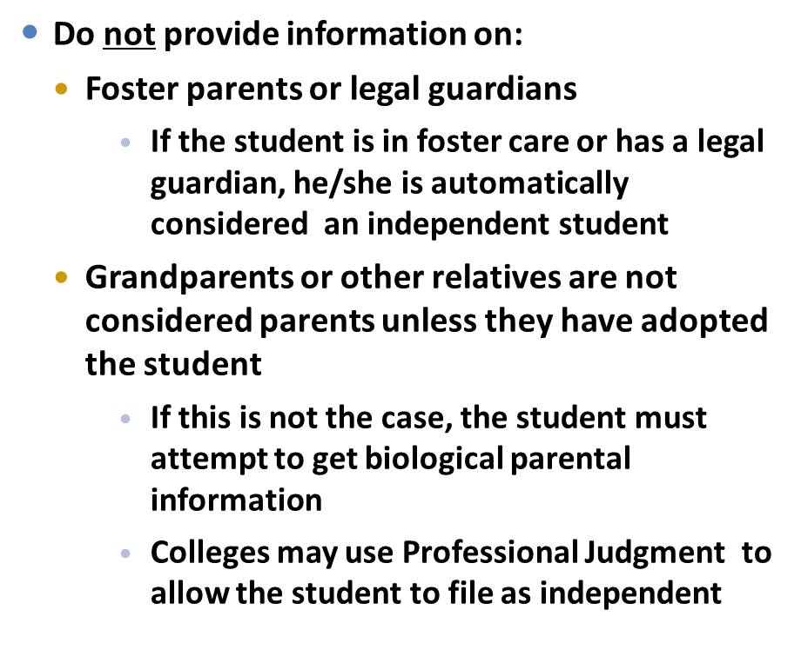

Section 4
Who is Not a Parent ?
Notes:
Who is NOT a Parent
A foster parent, legal guardian, grandparent or other relatives - such as aunts, uncles, or older siblings - are not considered as parents for purposes of filing a FAFSA unless that person has legally adopted the applicant.
If students are in this situation, they should contact the financial aid office at the colleges or universities they are most likely to attend before completing the FAFSA.
Again, students should not provide any financial information about
foster parent(s) or legal guardians
Because a foster child or a child who has a legal guardian is automatically considered an independent student
grandparents or other relatives
Students living with grandparents or other relatives must attempt to get biological parent information
Colleges may consider using Professional Judgment to make the student independent in rare cases.
PRESENTERS: Hide this slide and use it if questions come up about “Parent” definitions.

Slide 21

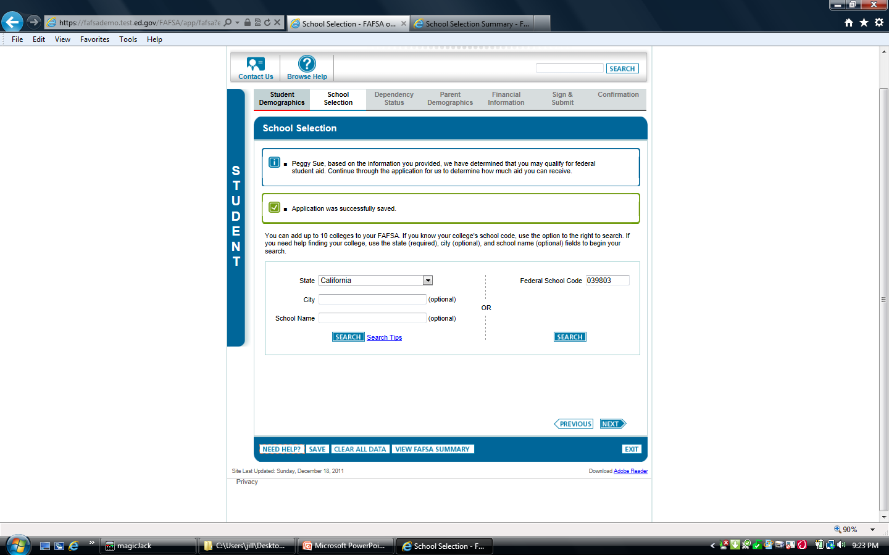
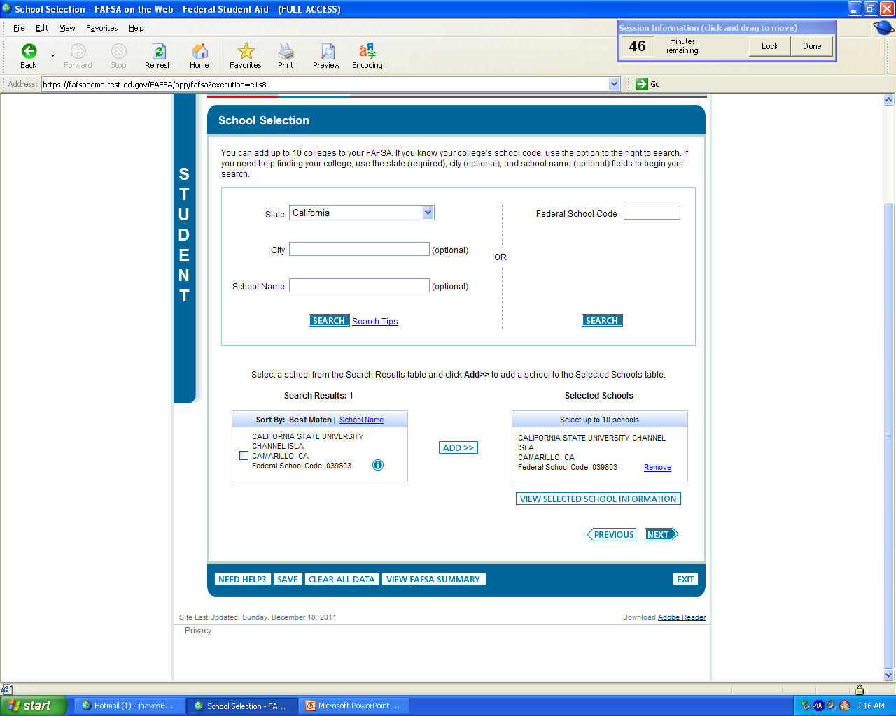
Section 2 - School Selection
While in the School Selection Section, the student will be asked to enter the location and name or the federal school code for each school to which he/she wants FOTW information sent
If the student does not know the federal school code, enter the state in which the college/university is located and search for the federal school code by the college/university name
Notes:
School Selection:
Students will need to use a federal school code for each of the schools they list in Section 2. Students can look up their school codes when they are completing this section of the FOTW. Be sure to enter the state where the school is located to make the search for the name of the college or university easier. This will give the student the federal school code. Please note that this code number is different from the SAT, ACT, and CSS/Financial Aid PROFILE code numbers.

Slide 22




Section 2 - School Selection
Strategies for Listing Colleges
FAFSA and CA Dream Act allow the student to list up to 10 colleges/universities that will receive his/her student and parent information
List a California college or university first (for Cal Grant consideration)
Then list those schools with the earliest financial aid deadlines, regardless of whether they are in-state or out-of-state
If the student is applying to more than ten schools, wait for the processed Student Aid Report (SAR) and add additional schools via the Web or by phone using the student PIN
NOTE: Each UC and CSU campus must be listed separately
Notes:
Here are some tips for completing Section 1 — especially if the student is applying for financial aid at more than ten colleges or universities.
Students should make sure to list a California college or university first.
Then list the schools with the earliest financial aid deadlines, regardless of the state where the schools are located.
Students should make sure to include their first and second choice schools.
It’s important to keep in mind that the U.S. Department of Education's processor will send data to only ten schools at a time for a student.
Students applying to more than ten schools can add additional schools when they receive their processed Student Aid Report (SAR). We strongly recommend that students sending their financial aid information to a large number of schools use FAFSA on the Web and sign the form using PINs. This will make adding additional schools even easier and faster.
For example, if the student originally listed ten schools on the application and then replaced all ten with new schools by changing his/her SAR, only the second set of ten schools will get new data from any subsequent corrections made to the FAFSA data. In this case, the student should alert schools in the first group of any changes.
Financial aid is awarded by each individual college or university campus. Therefore, each UC and CSU campus to which the student is applying for financial aid must be listed separately in Section 1 of the FOTW.
For Cal Grant Entitlement purposes, if a student decides to attend a school that is not the first choice listed on the FAFSA, the student should contact the California Student Aid Commission. Later in the presentation, we will provide more information about managing your Cal Grant online.

Slide 23

Section 5 - Parents’ 2014 Tax Return Filing Status
2014
The parents will be asked to provide information about their tax filing status for 2014:
  If parents have completed a 2014 federal income tax return, select “Already completed”
  If they have not as yet filed, but plan to file a 2014 federal income tax return, select “Will file”
  If they have not, nor will not, file a 2014 federal income tax return and are not required to do so, select “Not going to file”
Thresholds as provided by IRS:
• Single: $10,150 or more
• Married, filing jointly: $20,300
• Head of Household: $13,050
(Defined as someone who paid
more than half the costs of
keeping up a home for the year)
• Dependents (both children and adults) $6,200
Notes:
23
Parent s’ Tax Return Filing Status:
In this questions, parents will be asked to provide information about their tax filing status for 2011:
If the parents have completed a 2011 federal income tax return, the parents should select “Already completed”
If they have not as yet filed, but plan to file a 2011 federal income tax return, they should select “Will file”
If they have not, nor will not, file a 2011 federal income tax return and are not required to do so, they should select “Not going to file”

Slide 24

Section 5 – Parents’ 2014 Adjusted Gross Income
2014?
If the student’s parents have not yet filed their 2014 federal tax return, use estimated 2013 information for this question
The “Income Estimator” on the FOTW may help calculate this amount
If the student’s parents have completed their 2014 federal tax return, use actual 2014 tax return information to complete this item if they are not eligible to use the IRS Data Retrieval process
Notes:
Parents’ 2012 Adjusted Gross Income
The next question asks about parents’ 2012 adjusted gross income (AGI).
For parents who have not yet completed their 2012 federal tax return, the FOTW site provides an AGI Income Estimator which makes it easy to calculate an estimated AGI.
Remember, if custodial parents have not yet filed their 2012 federal tax return, it is fine to use estimated 2012 income information on the FOTW. There will be sufficient time to update this information when the parents complete their actual 2012 federal tax return.
If parents have completed their 2012 federal tax return, they should use actual 2012 tax return information to complete this item – either by using the IRS Data Retrieval process or their actual 2012 federal income tax return.
This question asks specifically about parents’ 2012 AGI. That is, the total of all taxable income they will list on their 2012 federal income tax form. This figure includes their wages as well as other taxable income such as interest and dividend income, business and rental property income, unemployment, as well as the taxable portion of pensions, IRA distributions, and Social Security benefits.

Slide 25






Section 5 - Money Earned from Work by Parent(s) in 2014
Use W-2 forms and other records to determine all income in 2014 earned from work (including business income earned from self-employment) for Parent 1 and/or Parent 2
Notes:
Money Earned from Work by Parents(s) in 2012
These next questions ask about custodial parent earnings from sources such as wages, salaries and tips. These questions must be answered whether or not the parents file a tax return. This information may be on their W-2 forms, or on IRS Form 1040, 1040A, or 1040EZ.
Parents who own a business or farm should report any income from these sources here as well so that Social Security taxes paid can be properly calculated.
It is important to list earnings correctly, because when the U.S. Department of Education calculates the parents' Expected Family Contribution (EFC), certain allowances are subtracted from the parents' income for required taxes and necessary expenses (such as income and Social Security taxes and basic living costs). The parents' income earned from work will also be used in the EFC calculation as an income factor when no tax form is filed.
Note to Presenters: FOTW asks separate questions about mother’s and/or father’s incomes from earnings. These questions are combined on the slide.

Slide 26
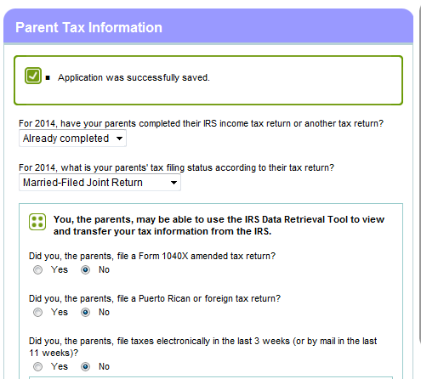
Section 5
IRS Data Retrieval
  This question asks if parents have completed their 2014 IRS income tax return
  If parent(s) answer “Already completed,” they will be given the option to transfer their 2014 income tax information directly from IRS records to the FOTW
  If parents indicate that they have recently filed their 2014 taxes, they may not be able to access their IRS data if they have filed taxes electronically within the last three weeks or by mail within the last eleven weeks
  Instead, they should use their actual 2014 IRS tax return to complete the FOTW so the student does not miss any important financial aid deadlines
Notes:
IRS Data Retrieval
This question may allow some parents who have already completed their 2014 federal income tax return to transfer their tax data from the IRS directly to the U.S. Department of Education. Parents will be instructed how to do this in this section of the FOTW.
If parent(s) answer “Already completed,” they will be given the option to transfer their 2014 income tax information directly from IRS records.
If parents have filed their 2014 taxes electronically within the last three weeks ago or by mail less than eleven weeks ago, they may not be able to access IRS data.
Some parents, regardless of when they filed their 2014 federal tax returns, will not be able to use this tool. These include those parents who:
are married and file separately;
file as Head of Household;
filed an amended federal tax return; or
filed a Puerto Rican or foreign tax return.
. . PRESENTERS: You might want to hide this slide and use it if questions come up about IRS Data Retrieval of 2014 federal tax return information.

Slide 27
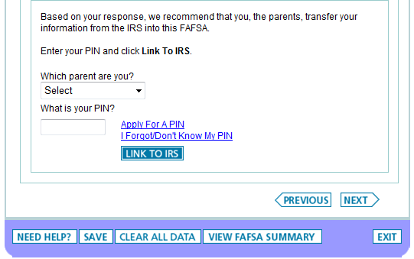
Section 5
IRS Data Retrieval (cont)
Notes:
IRS Data Retrieval (cont)
If, based on parents’ response to the IRS Data Retrieval questions, the IRS thinks that parental 2014 tax information can be transferred directly to the FOTW, the student will see the screen shown above. Parents can then initiate the data transfer.
PRESENTERS: You might want to hide this slide and use it if questions come up about IRS Data Retrieval of 2014 federal tax return information.

Slide 28
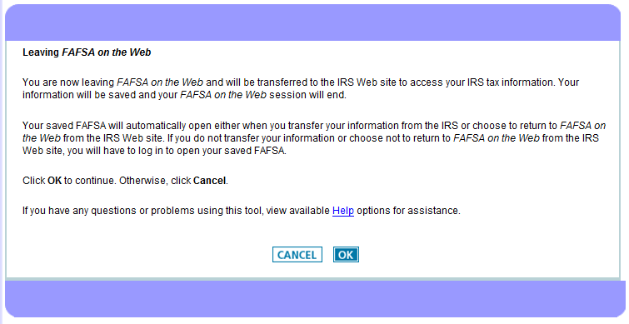
Section 5
IRS Data Retrieval (cont)
Notes:
IRS Data Retrieval (cont)
Initiating the transfer to the IRS site will take the parents away from the FOTW.
After authorizing the IRS data transfer, parents need to make sure to return to
the FOTW Website by clicking “OK”
If parents do not wish to transfer IRS data or return to the FOTW, they should hit
“Cancel.”
PRESENTERS: You might want to hide this slide and use it if questions come up about IRS Data Retrieval of 2014 federal tax return information.

Slide 29
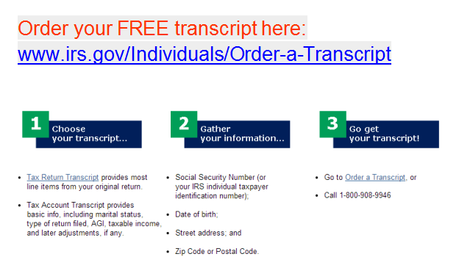
Section 5
IRS Tax Transcript
Notes:
IRS Tax Transcript
For parents who have filed their 2014 IRS tax return electronically at least three weeks prior to completing FOTW or their paper 2014 IRS tax return at least eleven weeks prior to this same time, it is possible to order an IRS tax transcript online at:
www.irs.gov/individuals/OrderaTranscript
This tax transcript may be used if the student’s FAFSA is chosen for Verification by the U.S. Department of Education or the college or university to which the student has applied. More information about Verification will be provided later in the presentation.
This transcript can also be obtained by calling: 1(800) 908-9946.
PRESENTERS: You might want to hide this slide and use it if questions come up about IRS 2014 Tax Transcripts.

Slide 30


Section 5
Parent Asset Information
Parents may be asked to report their assets as of the day they complete the FOTW if amounts exceed those shown in the question on the FOTW. If so:
Parent(s) must list the net value of their assets as of the day they complete the FOTW
If net worth is zero, enter 0
0
NOTE: Some financial aid offices may request supporting documentation for the answers to these questions
Notes:
Parent Asset Information
The purpose of collecting asset information is to determine whether the family's assets are substantial enough to support an additional contribution toward the student’s educational expenses. Only the net asset value is counted in the need analysis. To determine the net value of any asset, first determine the market value of the asset and then subtract the amount of debt owed on the asset. The result is the net value of the asset.
Section 5 (Financial Information) asks information about custodial parents’ assets as of the day the FOTW is actually completed in 2015. These questions are different than those that ask about 2014 parent income. We’ll talk more about assets in a moment.
If the answer to any question is zero, enter “0.”
Applicants should not leave any question blank.
Be as accurate as possible in reporting assets. Some financial aid offices may request documentation of reported amounts.
Presenters: You might want to hide this slide and use it if questions come up about parent assets.

Slide 31
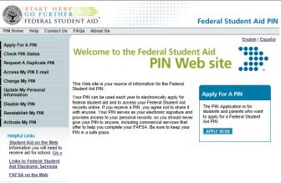
Federal PIN
PIN (Personal Identification Number)
  Needed to sign and access the FAFSA
Both student and one parent need PINs to sign the FAFSA electronically
May be used to:
  Check on FAFSA status
  Verify and correct FAFSA data
  Add additional schools to receive FAFSA data
  Change home and e-mail addresses
PIN will be generated only if a valid email address is provided
In late April 2015, the U.S. Department of Education will be switching from the current 4-digit FSA PIN to the FSA ID. The FSA ID is a new user-selected username and password.
Apply for student and parent PINs at:
www.pin.ed.gov
Notes:
Federal PIN
The PIN (personal identification number) serves as an electronic signature for U.S. Department of Education (DOE) documents, including the FOTW. The PIN works like the special number used for an ATM card. It identifies the student or custodial parent as those authorized to file an electronic FAFSA (FOTW).
If the student or parent has not yet applied for a PIN, the student and one custodial parent whose information is required on the FAFSA should go to the PIN website at www.pin.ed.gov. Students and parents can also apply for a PIN when completing the FAFSA on the Web, so don’t be concerned if you have not yet applied for PINs.
After applicants (students and one of their parents) provide their names, Social Security numbers, and other information on the PIN web site, the U.S. Department of Education will
e-mail the student and parent PINs within minutes ONLY if valid e-mail addresses for each is provided)
Parents and/or students who do have Social Security Numbers are not eligible to sign their FOTWs using a PIN, but can print, sign, and mail a paper Signature Page after completing FOTW. Directions can be found on the FOTW Signature Page by clicking the “Other options to sign and submit” link.
In late April 2015, the U.S. Department of Education will be switching from the current 4-digit FSA PIN to the FSA ID. The FSA ID is a new user-selected username and password. This will not affect students who obtain their PINs before this change.

Slide 32
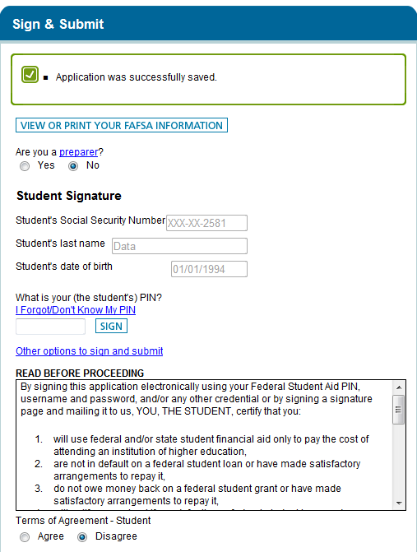
Section 6
Student Signature Page
Sign and Submit
  Recommend that students sign the FAFSA electronically using their PINs
  Remember to read and mark “Agree” to the student Terms of Agreement
Notes:
Student Signature Page
It is important that both students and their custodial parents read the FAFSA on the Web Certification Statement before submitting the FAFSA. They should be sure they understand to what they are agreeing.
All students (and at least one of their custodial parents, if dependent) must sign the FAFSA. When submitting the FOTW, students and at least one of their custodial parents must provide their own individual PINs. Remember, students and their custodial parents can get their PINs at www.pin.ed.gov or when they complete the FOTW. Students and parents should not share their PINs with anyone else.
We recommend signing the FAFSA electronically with the student PIN, so the student applicant does not need to print, sign, and mail a signature page.
Also, make sure to read and mark “Agree” to the student Terms of Agreement.
Presenters: You might want to hide this slide and use it if questions come up about the Student Signature Page.

Slide 33
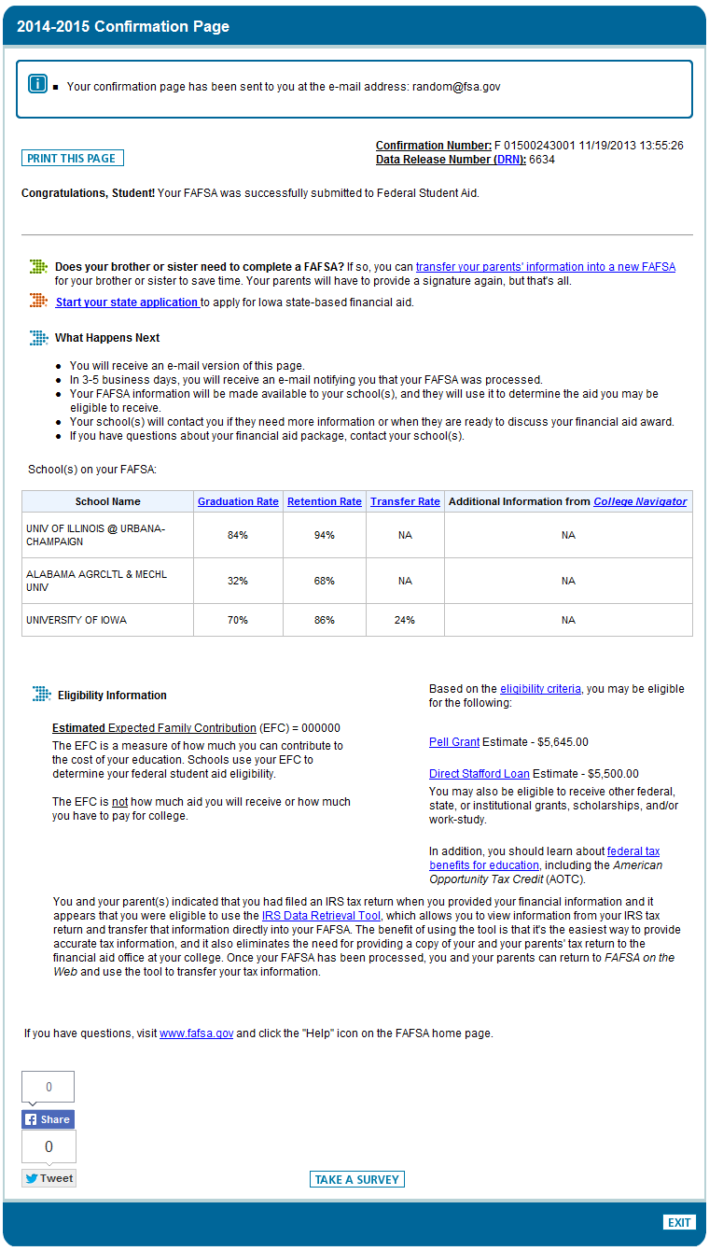
Section 7
Confirmation
2015-2016 Confirmation Page
Confirmation Page
  Confirms date and time of submission of the FOTW to the U.S. Department of Education
  Shows
    Expected Family
    Contribution (EFC)
    Estimated Federal Pell Grant and Federal Stafford Loan eligibility
    List of schools to receive FAFSA data
Notes:
Confirmation Page
The student should choose to print the Confirmation Page and save a copy.
This page confirms the date and time of submission of the FOTW to the U.S. Department of Education.
In addition, it shows the student’s Expected Family Contribution (EFC), estimated Federal Pell Grant and Federal Stafford Loan eligibility, as well as
the list of schools scheduled to receive FAFSA data. The Confirmation Page also indicates important information about each college or university listed.
Each time a student makes FOTW corrections, a new Confirmation Page will be available which will reflect the changes made.
Presenters: You might want to hide this slide and use it if questions come up about the Confirmation Page.

Slide 34

Special Circumstances
Contact the Financial Aid Office if there are circumstances which affect a family’s ability to pay for college such as:
  Loss or reduction in parent or student income or assets
  Death or serious illness
  Natural disasters affecting parent income or assets such as the recent California wind storms, wild fires, floods, or mudslides
  Unusual medical or dental expenses not covered by insurance
  Reduction in child support, Social Security benefits or other untaxed benefit
  Financial responsibility for elderly grandparents, or
  Any other unusual circumstances that affect a family’s ability to contribute to higher education
Notes:
Special Circumstances
Many families have special circumstances not reflected by the questions on the FAFSA. Families are encouraged to contact the Financial Aid Office at each of the schools to which they are applying for admission and financial aid if there are significant changes in their circumstances such as:
A loss or reduction in parent or student income or assets
A death or serious illness
Natural disasters that affect parent income or assets – this is especially true for any family adversely affected by the recent California wind storms, wildfires, floods, or mudslides
Unusual medical or dental expenses not covered by insurance
Reduction in child support or Social Security benefits
Financial responsibility for elderly grandparents, or
Any other unusual circumstances that affect a family’s ability to contribute to higher education.
If the family feels there are special circumstances that may affect their ability to contribute to college, it is important that they present their case in a way that helps the financial aid office understand their unique challenges. Some schools will provide special forms to help the family provide the appropriate new information. Families are encouraged to:
Contact the financial aid office for guidance
Write a detailed explanation of circumstances
Include student’s name, college or university ID#, and date of birth
Give specific financial details including the reasons why the circumstances affect the family’s ability to contribute
Attach supporting documentation
Send to the financial aid office at each school to which the student is applying for admission and financial aid
Each financial aid office will make its own decision about the effect the special circumstances have on a student’s need. Not all aid offices will be able to provide additional funds if there are special circumstances, but they might be able to suggest other options.

Slide 35

Application Filing Tips
FAFSA on the Web
Gather necessary documents ahead of time
Complete a FAFSA on the Web available at: www.fafsa.ed.gov
Allow ample time to complete the online FOTW application for submission by the deadline
Check the FAFSA on the Web for accuracy prior to submission
Save all work periodically
Sign the application using student’s and one custodial parent’s PINs
Print and keep a copy of the FAFSA before submitting data
Print and keep a copy of the Submission Confirmation Page
Notes:
Application Filing Tips
Let’s review some application filing tips for the FAFSA on the Web:
Gather necessary documents ahead of time so that completing the application is faster and easier;
Complete the 2015-16 FAFSA on the Web by going to www.fafsa.ed.gov.;
Allow ample time to complete the FAFSA for submission by published deadline(s). Don’t wait until the day the application is due. Assume that the electronic deadline is East Coast time, not California time;
Check the FOTW for accuracy prior to submission;
Save your work often. We all know how frustrating it is to work on something electronically and lose it because we have not saved it;
Sign the application using the student’s and one custodial parent’s PINs;
Print out a copy of the FOTW before submitting data electronically; and
Print and keep a copy of the Submission Confirmation Page and Student Aid Report (SAR) or SAR Acknowledgement for your financial aid file.

Slide 36
What Happens Next?
Students and the colleges the student listed receive Student Aid Report (SAR) from federal processor
ê
Students who complete FAFSA and Cal Grant GPA Verification Form receive California Aid Report (CAR)
ê
Students and families review SAR and CAR for important information and accuracy of data
ê
Colleges match admission records with FAFSA and other required financial aid forms to determine aid eligibility
ê
Colleges provide notices of financial aid eligibility to admitted students who have completed all required financial aid forms
Notes:
What Happens Next
Shortly after completing the FOTW, the student should receive a Student Aid Report (SAR) from the federal processor. The SAR summarizes the information the family provided on the FAFSA. Each school listed on the SAR will also receive the information electronically. If the student does not receive the SAR within two weeks, he/she should contact the federal processor to check on the status of the FAFSA. Call 1-800-4-FED AID (that’s 1-800-433-3243) or check on the status of your FAFSA by going to FAFSA.gov using the student PIN.
When the California Student Aid Commission evaluates the student’s FAFSA and Cal Grant GPA Verification Form, the student will receive a California Aid Report (CAR) that will provide the student with information about his/her Cal Grant eligibility.
Students who complete the CA Dream Act Application will be able to view their CalSAR immediately upon submitting their application.
Once each school receives the electronic SAR and all other required financial aid forms, and confirms the student’s admission status, the financial aid office will determine the student’s financial aid eligibility. Some schools may request that the student submit income documentation such as student and parent 2014 federal income tax returns (including W-2s and all schedules and attachments) or 2014 Federal IRS Tax Transcripts, before sending the student a final determination of eligibility. The school will use these and any other requested information to verify the accuracy of the data provided on the FAFSA. Schools understand that many families have used estimated data.
A financial aid notification (commonly referred to as an award letter) describing the amounts and sources of aid the student has been awarded will be prepared for the student when the student’s financial aid application is complete. Most schools will wait until the student has been accepted for admission to notify him or her about financial aid eligibility. Some schools will mail a paper notification to the student; others may provide the award letter electronically.
In some cases, the student will be required to sign and return a copy of the financial aid notification, indicating whether he/she accepts or declines each source of aid.
If family circumstances change after the student completes the FAFSA and other required financial aid documents, make sure to contact the financial aid office at each school as soon as possible.

Slide 37
Federal Verification
Some students may be required to verify the information reported on the FAFSA
If selected for verification, the tax information of federal tax filers will be verified through
  The IRS Data Retrieval Process, or
  IRS Tax transcripts if requested by the college or university
Non-tax filers selected for verification may be asked to provide
  Signed statements confirming that they did not file a 2014 federal tax return and were not required by IRS to do so
  Copies of W-2s or other income documentation from each employer , if any income was earned from work
All selected aid applicants will also be asked to verify certain demographic data listed such as
  Household size and number in college
  Child Support paid and SNAP, if reported on the FAFSA
  Enrollment History for transfer students
  Identity Confirmation
Notes:
Federal Verification
In order to assure that information provided by students and parents is accurate, the U.S. Department of Education requires colleges and universities to verify the accuracy of financial and other demographic information provided on the FAFSA. Verification of FAFSA data helps colleges and universities accurately and equitably determine the types and amounts of federal funding students will receive. Students whose FAFSA data is chosen for Verification will see an asterisk next to the EFC on their SAR.
If selected for verification, the tax information of federal tax filers will be verified through
The IRS Data Retrieval Process, or
IRS Tax Transcripts if requested by the college or university.
Federal Tax Transcripts are available free of charge at:
www.irs.gov/individuals/order-a-transcript
or by calling 1-800-908-9946.
Non-Tax filers selected for verification may be asked to provide
Signed statements confirming that they did not file a 2014 federal tax return and were not required by IRS to do so; and
Copies of W-2s or other documentation from each employer, if any income was earned from work.
All selected aid applicants will also be asked to verify certain demographic data listed such as
Household size and number in college,
Child Support paid and SNAP, if reported on the FAFSA
Enrollment History for transfer students
Identity Confirmation.
Some colleges and universities may require the verification of additional information for determining eligibility for state and their own student aid funds.

Slide 38
Check Your Cal Grant
By opening a WebGrants Account a student can:
Check Cal Grant award status 24/7
Confirm student’s high school graduation as required
Make changes to Cal Grant school choices
View how much a Cal Grant is worth at different California colleges and universities
View Cal Grant payment history
Create a WebGrants account at: www.webgrants4students.org
Notes:
Check Your Cal Grant
Students are encouraged to open a WebGrants account to manage their Cal Grant. After doing so, they can
- Check their Cal Grant application and award status 24/7
- Confirm their high school graduation as is required to receive Cal Grant payment
- Make changes to their Cal Grant school choices
- View how much their Cal Grant may be worth at different California colleges and universities as well as
- View their Cal Grant payment history
In addition, they can click on links to other financial aid information and web sites.
Students can create a WebGrants account at: webgrants4students.org

Slide 39

If You Need Help at Any Time
FAFSA on the Web – Live Help
Phone 1-800-4-FED-AID (1-800-433-3243)
E-mail the U.S. Department of Education at: FederalStudentAidCustomerService@ed.gov
Notes:
If You Need Help at Any Time
The U.S. Department of Education is always willing to provide assistance to students and families completing the FAFSA and to answer questions relating to federal financial aid.
The FOTW has help buttons right on the electronic form as you go through the application.
In addition, you can use the following:
FAFSA on the Web – Live Help;
Phone 1-800-4-FED-AID (that’s 1-800-433-3243); or
E-mail the U.S. Department of Education at:
FederalStudentAidCustomerService@ed.gov

Slide 40

Q & A
Q & A
Q
&
A
Q
&
A
Q
&
A
Q
&
A
?
Q & A
Q & A
Notes:
Questions and Answers
We hope you have found this workshop helpful.
We will now be glad to answer any general questions you and your family might have.
After a brief question and answer period, volunteers will be available to help you complete the 2015-16 FAFSA on the Web, the 2015-16 Cal Grant GPA Verification Forms, and answer any questions about other financial aid documents.

