Slide 1


Solicitud de Ayuda Financiera
2015-2016
Notes:
Thank you for coming to our California Cash for College workshop.
Today, we will be discussing how to apply for college financial aid for the
2015-16 academic year.

Slide 2
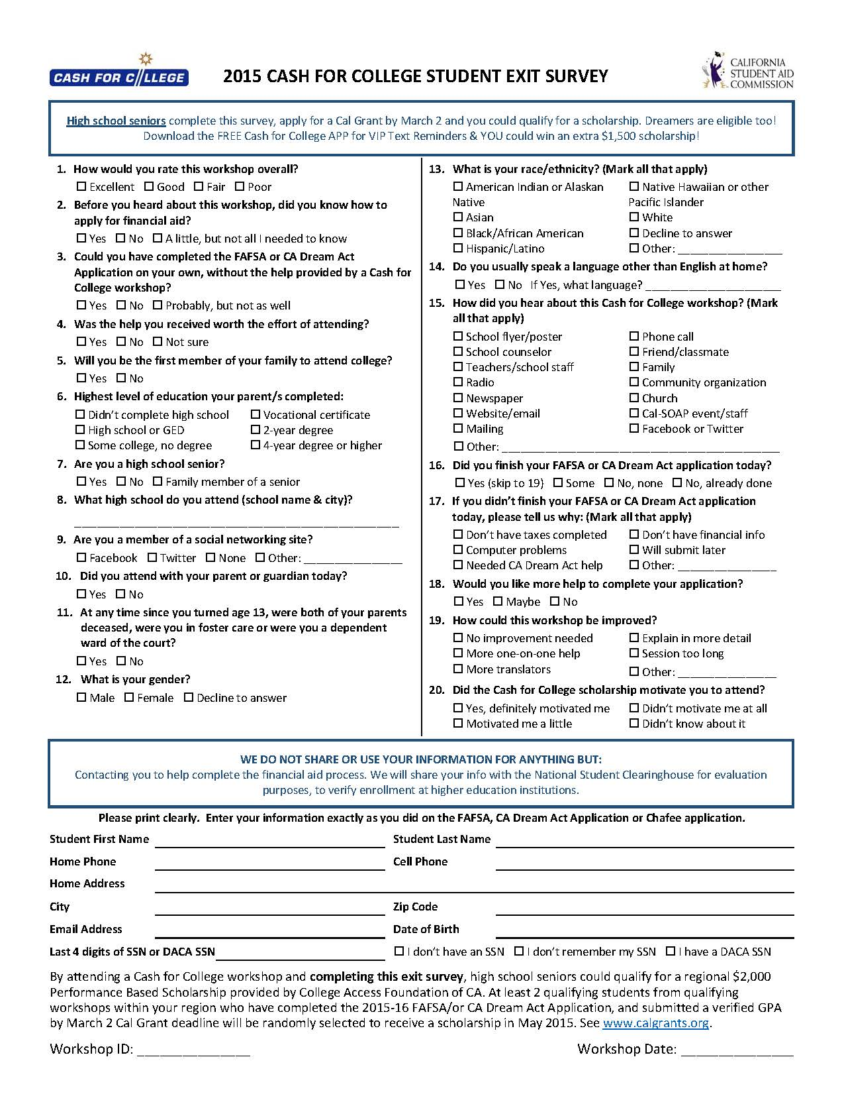
Cash for College Beca de $2,000 Evaluación
Complete y entregue la evaluación ANTES de irse!
Se deberia de completar por computadora en el taller
Si lo entrega por pael, escriba claro
Debe enviar la FAFSA o DREAM Act y Cal Grant GPA no más tarde del 2 de Marzo
El ganador/a se eligirá después del 2 de Marzo y será anunciada por tu consejero o por carta enviada a la dirección que nos hayas dado.
2
Notes:
2
Each of you should have a folder with lots of useful information
- the Cash for College Evaluation
- the 2009-2010 on-line Free Application for Federal Student Aid (FAFSA on the Web Worksheet) and
- the 2009-2010 Cal Grant GPA Verification Form
If you do not have copies of these forms, please raise your hand so we can get them to you.

Slide 3

Tipos de Ayuda Financiera
Ayuda Gratuita – Becas por necesidad o mérito sin costo al estudiante.
Trabajo – Dinero que el estudiante obtiene como sueldo de un trabajo dentro o fuera del campus
Préstamos – Dinero prestado que debe ser pagado, generalmente con intereses
Notes:
Types of Financial Aid
There are three major types of financial aid – grants and scholarships, work-study, and educational loans.
Grants and scholarships are gift aid that does not need to be earned or require repayment. Grants are usually based on the student’s financial need. Scholarships are generally based on talent and/or merit.
While there are a number of grants and scholarships available to California students, the Cal Grant program is one of the most widely available. Cal Grants are an example of gift aid based on need and merit. We will discuss Cal Grants in more detail later in the presentation.
Work programs provide opportunities for students to earn money to help pay for school expenses.
Both students and parents can borrow from a variety of low interest educational loan programs designed to help with the educational expenses of the student. Student loans usually do not require repayment until the student is no longer in school. Parent loans may require payment while the student is still in school.

Slide 4

Fuentes de Ayuda Financiera
Gobierno Federal
Gobierno Estatal
Colegios y Universidades
Agencias privadas, compañías, fundaciones, y los empleadores
Notes:
Sources of Financial Aid
By completing the financial aid applications and any other documents required by the colleges and universities to which the students are applying, they may be considered for funds from:
- the federal government;
- the state government; as well as
- colleges and universities themselves.
Private agencies, companies, foundations, and maybe even the students’ and parents’ employers provide scholarships for college. Though important, these sources provide less than 6% of the total financial aid awarded to students. Check with each of the private agencies, companies, and foundations to which the students wish to apply about application forms and deadlines. Web sites such as www.studentscholarshipsearch.com, www.fastweb.com and www.finaid.org are good resources for such scholarships.

Slide 5
Becas Cal Grant
Cal Grant A por Derecho - para estudiantes del último año de secundaria y los recientemente graduados
  con un promedio de calificaciones (GPA) de al menos 3.0
  ingresos y bienes familiares bajo el límite máximo estatal
  quiénes demuestren necesidad financiera
Cal Grant B por Derecho - para estudiantes del último año de secundaria y los recientemente graduados
  con un promedio de calificaciones (GPA) mínimo de 2.0
  quiénes vienen de familias en desventaja o de bajos recursos
  quiénes ingresos y bienes familiares están bajo el límite máximo estatal
  quiénes demuestran necesidad financiera
Cal Grant C - para estudiantes de familias de bajos recursos que desean estudiar en programas vocacionales
Notes:
Cal Grants
Let’s talk about Cal Grants – an important source of grant funds provided by the State of California for California students. Students planning to attend a California college or university may be eligible to receive one of the following Cal Grants. High school Grade Point Average (usually referred to as the GPA) is an important eligibility criterion for these grants. The Cal Grant GPA is calculated using grades from sophomore and junior years of high school and any summer grades after each of those years. Awarded grants may be renewed if students and their families continue to meet all eligibility requirements.
Please note: for purposes of the Cal Grant A and B Entitlement Awards, a “recent high school graduate” is defined as a student who is applying for a Cal Grant within 18 months of high school graduation.
Cal Grant A - To be eligible, students need a minimum 3.0 GPA - that is a B average on a 4.0 scale. Their families must have income and assets that are lower than the state-established ceilings and must demonstrate financial need of at least $1,500 at the college they plan to attend. This grant currently covers system-wide fees at the California State University and University of California campuses and up to $9,084 of tuition and fees at independent California colleges and universities.
Cal Grant B - This grant is for students who have a minimum 2.0 GPA - that is a C average. The students must come from low income disadvantaged families, meet state income and asset ceilings and demonstrate financial need of at least $700. This grant provides a small stipend of about $1,648 per year for up to four years to help with living expenses at all schools. In addition, the grant covers system-wide fees at California public 4-year institutions and up to $9,084 of tuition and fees at independent 4-year California schools. Students attending for-profit career colleges currently receive grants between $4,000 and $9,084 per year. In most cases, the tuition and fee portion of the Cal Grant B is available to students in their 2nd through 4th years only.
Cal Grant C - This grant is for students from low income families attending occupational or vocational schools including community college programs of less than 24 months in length. The Cal Grant C may renewable for one additional year if student and family continue to meet state-established income and asset ceilings.
Priority for Cal Grant C is now given based on Occupational Goals that meet two of the following:
high employment need;
high employment growth; and
high wages.
.

Slide 6

Elegibilidad para Cal Grants
Para ser elegible para Cal Grant, el estudiante también debe:
  ser un ciudadano de los EE.UU., no ciudadano elegible, o estudiante AB540 - incluyendo estudiantes AB540 elegibles bajo DACA
  ser residente de California
  asistir a un colegio o universidad elegible y acreditada de California por lo menos medio tiempo en el año escolar 2015-2016
Notes:
Additional Cal Grant Requirements
To be eligible for a Cal Grant, the student must also:
be a U.S. citizen or eligible noncitizen as defined in the Free Application for Federal Student Aid (FAFSA). If a student qualifies under AB540, he/she may qualify for Cal Grant funding. This includes Deferred Action Childhood Arrivals (DACA) who are AB540 eligible.
(We’ll talk more about what this means later in the session as well as which application the students should complete);
be a California resident; and
attend an accredited California college or university at least half-time in the 2015-2016 academic year and each subsequent term the student is enrolled.

Slide 7

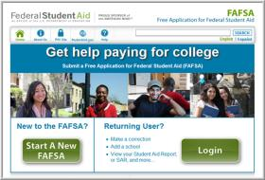
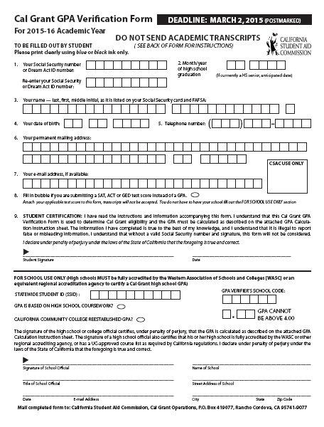

2015-2016 Cal Grant
Requisitos de la Aplicación
A más tardar el 2 de marzo, 2015, llene y envíe :
Solicitud Gratuita de Ayuda Federal para Estudiantes
(FAFSA)
Formulario de Verificación del GPA de Cal Grant
Si es elegible bajo AB540, o DACA, los estudiantes deben completar la Aplicación de
California Dream Act www.caldreamact.org
Consulte con su consejero para más detalles sobre cómo presentar el Formulario de
Verificación del GPA de Cal Grant, se requiere de todos los estudiantes
Notes:
Cal Grant Application Requirements
In order for a student to be considered for a first-time 2015-2016 Cal Grant, the California Student Aid Commission (CSAC) requires that he/she submit both the Free Application for Federal Student Aid and the Cal Grant GPA Verification Form by March 2, 2015. We encourage all applicants for federal and state aid to file as soon as possible after January 1, 2015.
Students who may be eligible for Cal Grants under AB540 should complete the California Dream Act application at www.caldreamact.org instead of the FAFSA. This includes AB540 eligible DACA students. The Cal Grant GPA Verification Form is also required.
Students with a Deferred Action Childhood Arrivals (DACA) status who are not AB540 eligible should also complete the California Dream Act Application. They should also check with the colleges and universities to which they apply to see if they should alomplete any other forms.the Free Application for Federal Student Aid (FAFSA or other forms), but should complete the California Dream Act Application first.
Most high schools submit student grade point averages directly to CSAC on behalf of their students. Others require that students complete the student section of the Cal Grant GPA Verification Form. (The student section of the form asks simple information such as the student’s name, address and Social Security Number). If the paper form is required, it is important to submit it as soon as possible to the high school counselor or registrar because it may take a few days to certify the student’s grade point average. The student can download a Cal Grant GPA Verification Form at: www.calgrants.org. The GPA Verification Form must be postmarked no later than March 2, 2015.
Check with the student’s high school Counseling Office/Guidance Center to see if he/she needs to submit the paper Cal Grant GPA Verification Form or if the high school will submit the GPA electronically on the student’s behalf. If the high school submits the Cal Grant GPA Verification Form electronically, the student may have to authorize the release of his/her Social Security Number.
We urge students to file these forms as soon as possible. Don’t wait for the March 2nd deadline and miss out on a valuable grant that, like other grants, does not have to be repaid.
Students who have qualified and received a Cal Grant for the previous school year should complete the 2015-2016 FAFSA as soon as possible after January 1, 2015 and check with the financial aid office at the school they will attend for any other requirements. The GPA Verification Form is not required.

Slide 8

Becas de la Clase Media
Los estudiantes universitarios de familias con ingresos de hasta $150,000 que:
  Envían la 2015-16 Solicitud Gratuita de Ayuda Federal para Estudiantes (FAFSA) a más tardar el 2 de marzo, 2015
  Asistan a una UC or CSU
  son ciudadanos estadounidenses, residentes permanentes o AB540
  son residentes de California, y
  mantienen un GPA acumulativo de 2.0
Cantidad del premio anual:
  Será determinado por la Comisión de Ayuda Estudiantil de California
Notes:
The Middle Class Scholarship
The Middle Class Scholarship (MCS) is designed to assist California residents who are new and continuing UC and CSU undergraduate students with family incomes up to $150,000.
To apply for the MCS for 2015-16, students must submit, by March 2, 2015, the:
- 2015-16 FAFSA
- For AB540 students, the 2015-16 California Dream Act Application. This includes AB540 eligible DACA students
MCS awards vary based on the number of eligible students, the institution, and state funding allocated. In 2015-16, maximum awards will range up to $2,438.
Amounts are determined after Federal Pell Grants, Cal Grants and institutional grants are awarded. Students cannot receive both federal and/or state grant aid and the MCS.
Qualifying students will be notified by the California Student Aid Commission. The Commission will also determine the maximum awards.
For renewal, student must maintain a cumulative 2.0 GPA, continue to meet all eligibility requirements including completing the FAFSA or the California Dream Act application by the appropriate deadlines.

Slide 9

Becas Chafee de California
El programa de becas Chafee de California proporciona hasta $5,000 anualmente a jóvenes que están o estuvieron en un hogar adoptivo temporal, para la universidad o capacitación vocacional en cualquier universidad acreditada en los Estados Unidos dependiendo en los fondos disponibles
Para ser elegibles, los jóvenes en hogares adoptivos temporales deben haber cumplido los 16 años bajo cuidado adoptivo temporal y no pueden llegar a tener 22 años antes del 1 de julio de 2015
Los jóvenes en hogares adoptivos temporales son alentados a aplicar durante su último año de escuela secundaria
Para aplicar, los jóvenes en hogares adoptivos temporales deben llenar:
  2015-2016 FAFSA
  La solicitud del Programa de Becas Chafee de
  California
  Los estudiantes AB540 también pueden ser elegibles
Para aplicar para una beca
Chafee, visite: www.chafee.csac.ca.gov
Notes:
Chaffee Grant
If the student is a current or former foster youth, the California Chafee Grant may provide some additional financial aid for college. If you are the foster parent or know a foster youth, tell him/her about this special program for foster children.
The California Chafee Grant program provides up to $5,000 annually to current and former foster youth for college or vocational training at any accredited college in the U.S. The continued availability of this grant is dependent on available funding.
To be eligible, foster youth must have been in California foster care on their 16th birthday and may not have reached their 22nd birthday before July 1, 2015.
Students are encouraged to apply during their senior year of high school.
To apply, the foster youth must complete:
- 2015-16 FAFSA
- AB540 students should complete the California Dream Act Application.in place of the FAFSA. This includes AB540 eligible DACA students
- California Chafee Grant Program Application
To learn more about the Chafee Grant, go to
www.chafee.csac.ca.gov

Slide 10


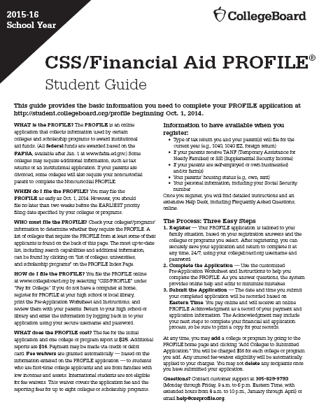
Tipos de Solicitudes
FAFSA www.fafsa.gov
Estudiantes indocumentados que califican bajo la ley AB540 o DACA deben completar la aplicación del Dream Act de California www.caldreamact.org
Formulario de Verificación del GPA de Cal Grant
Otras solicitudes que pueden ser requeridas por
los colegios tales como:
CSS/PERFIL de Ayuda Financiera
    Solicitud de beca institucional y/o solicitud de ayuda financiera
    Declaración federal de impuestos 2014 (junto con todos los anexos y formularios W-2) o la documentación de otros ingresos
Notes:
Types of Applications
There are a number of important financial aid forms:
-The Free Application for Federal Student Aid (FAFSA) is required by all colleges and universities for the awarding of federal and state aid. Every student should complete the FAFSA. In some instances, a school may use the FAFSA for institutional aid as well. The FAFSA should be completed by students and their families in electronic format (FAFSA on the Web). We will discuss the FAFSA on the Web in greater detail in just a few minutes
- Undocumented students covered under AB540 or DACA should complete the California Dream Act Application.
- As previously mentioned, in order to be considered for a Cal Grant, students must also complete the Cal Grant GPA Verification Form. This form must be certified by their high school and submitted to the California Student Aid Commission (CSAC) by March 2, 2015.
-The CSS/Financial Aid PROFILE is used by many private or independent colleges and universities as well as a few public universities outside of California to determine eligibility for their own funds. Some scholarship competitions may also require the CSS PROFILE.
- Some colleges or universities may require their own scholarship or financial aid applications in addition to the FAFSA. The additional forms, such as those for the Community College Board of Governors (BOG) Fee Waiver, may collect information not requested on the FAFSA. These forms help the institution award its own funds and must be returned to the college or university directly.
- As noted earlier, many employers, organizations, and community-based agencies offering scholarships require students to complete separate applications.
- Many colleges will request copies of student and parent 2014 federal tax returns and other income documentation. We suggest the student and parents complete their 2014 federal income tax forms as soon as possible. Make sure to keep copies of these forms along with all schedules and W-2’s.
- Also, be sure to submit any required applications or requested documents by the published deadlines. At many institutions, failure to meet a deadline may jeopardize student eligibility for grants and other types of aid. We cannot emphasize this enough – don’t miss out on financial aid or college opportunities by missing a deadline.

Slide 11
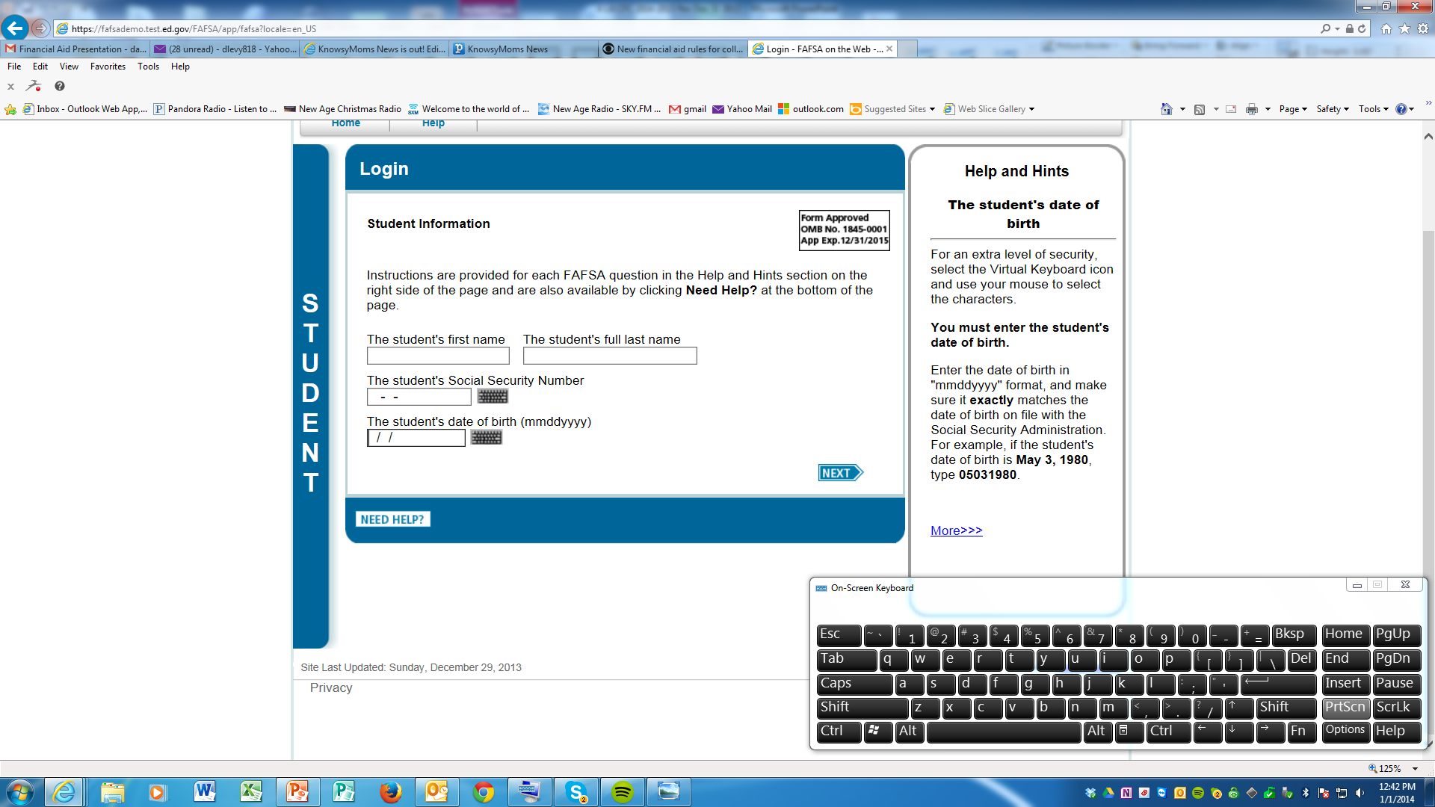

Entrar
Form Approved
OMB No. 1845-0001
App Exp. 12/31/2016
El FOTW le pedirá el nombre y apellido del alumno
Asegúrese de reportar el nombre del estudiante tal y como aparece en la tarjeta de Seguro Social del estudiante
Notes:
Student Name
It is important to list the student’s name exactly as it is shown on the student’s Social Security card. The FOTW will ask for the student’s first and last name. For example: report Susan Jones, not Suzie Jones, if Susan is the student’s first name on the Social Security card.

Slide 12


Parte 1 - Condición de Ciudadanía
Si es ciudadano de Estados Unidos, el estado será confirmado al comparar el Seguro Social
Si es elegible pero no ciudadano, esta condición será confirmada por el Departamento de Homeland Security (DHS). Esto incluye::
  Residentes permanentes de los Estados Unidos con I-551
  Residentes condicionales con I-551C
  El titular de un Registro de Llegada-Salida (I-94) por el Departamento de Homeland Security que muestra alguna de las siguientes categorías: “Refugiado”, “Asilo otorgado”, “libertad condicional” (I-94 que confirma la libertad condicional por un período mínimo de un año y su estado no ha caducado), titular de la Visa T (T-1, T-2, T-3, etc.) o “entrante cubano-haitiano"
  El titular de un certificado válido o carta de elegibilidad del Departamento de Salud y Servicios Humanos que muestra la denominación de "víctima de trafico humano.”
  Un residente de la República de Palau (PW), la República de las Islas Marshall (MH), o de los Estados Federados de Micronesia (FM)
  Nativos Americanos nacidos en Canadá, bajo los términos del Tratado de Jay
Notes:
12
Student Citizenship Status
Students must be U.S. citizens or eligible noncitizens to receive federal student financial aid. If a student has recently become a U.S. citizen, he/she should contact the Social Security Administration (SSA) to update his/her status. Otherwise, when the U.S. Department of Education matches data with the SSA, the Agency may report that the student is not a citizen and may be considered ineligible to receive federal and state aid.
Some students who are not U.S. citizens or eligible noncitizens may be eligible for Cal Grants and/or aid provided by the college or university to which the students are admitted. These students are those who qualify under the California Dream Act and are AB540 eligible. DACA recipients should complete the California Dream Act Application – not the FAFSA.
For financial aid purposes, an eligible noncitizen is someone who meets one of the following criteria:
-A U.S. permanent resident with a Permanent Resident Card (I-551),or
-A conditional permanent resident with a Conditional Green Card (I-551C), or -Other eligible noncitizen with an Arrival-Departure Record (I-94) from the Department of Homeland Security showing any of the following designations: “Refugee,” “Asylum Granted,” “Parolee” (I-94 confirms paroled for a minimum of one year and status has not expired), T-Visa holder (T-1, T-2, T-3, etc.) or “Cuban-Haitian Entrant;” or
-The holder of a valid certification or eligibility letter from the Department of Health and Human Services showing a designation of “Victim of human trafficking.”
- A resident of the Republic of Palau (PW), the Republic of the Marshall Islands (MH), or the Federated States of Micronesia (FM)
- A Canadian-born Native American under terms of the Jay Treaty.

Slide 13
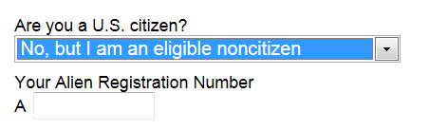
Parte 1 – No Ciudadano Elegible
Si es no ciudadano elegible, escriba su número de registro de extranjero (ARN) de ocho o nueve dígitos
Escriba un cero antes de un ARN de ocho dígitos
Es posible que se solicite una copia de la tarjeta de registro permanente en la oficina de ayuda financiera
Si no es ciudadano o no ciudadano elegible, el estudiante no es elegible para ayuda federal. Estos estudiantes deben verificar con la oficina de ayuda financiera para otras oportunidades de ayuda financiera
Si el estudiante es indocumentado (como definido bajo la ley AB540), puede ser elegible para ayuda financiera estatal bajo el California Dream Act. Visite www.caldreamact.org
Notes:
13
Eligible Noncitizen
If students indicate “eligible noncitizen,” they should write in their 8- or 9-digit Alien Registration Number. Students should precede an 8-digit number with a zero.
Students who list their Alien Registration Number may be asked by the colleges or universities to provide a copy of their Permanent Registration Card.
Some recently naturalized citizens may also be asked to provide a copy of their Naturalization documents. It is legal to photocopy these documents for financial aid purposes.
Neither Citizen nor Eligible Noncitizen
If students are in the U.S. on:
- an F1 or F2 student visa;
- a J1 or J2 exchange visitor visa;
- a G series visa (pertaining to international organizations), or
- other categories not included under U.S. citizen and eligible noncitizen
they are not eligible for federal student aid and should not complete a FAFSA unless instructed to do so by the financial aid offices of the colleges or universities to which they are admitted. The financial aid office will help these students complete the correct forms.
The following students are not eligible to file a FAFSA or a California Dream Act Application and should contact their campus financial aid office for assistance to see what kind of financial aid they may be eligible to receive and what forms they should complete. These students are:
Non-immigrants granted one of the following visas: A, B, C, D, E, F, G, H, I, J, K, L, M, N, O, P, Q, R, S, TN, TD, V, TROV, and NATO.
T visa holders are eligible to apply for federal and California student financial aid. T visa holders should file a FAFSA and identify themselves as eligible non-citizens.
U visa holders are not eligible for federal student financial aid, but they are eligible for California student financial aid. U visa holders must file a California Dream Act Application.
If the student is undocumented as defined in AB540, he/she may be eligible for state financial aid. Learn more at www.caldreamact.org.
If students are in the U.S. and have been granted Deferred Action Childhood Arrivals (DACA), they should complete the California Dream Act Application.
Students with an F1 or F2 visa, a J1 or J2 exchange visitor visa or a G series visa, should select “No, I am not a citizen or an eligible noncitizen.” Such students are not eligible for federal aid and should not complete the FAFSA unless a college or university instructs the student to do so.
We will provide information about some free scholarship searches for students in one of these ineligible categories or who are undocumented students in the next slide.

Slide 14

Parte 1
Estudiantes Indocumentados
Los estudiantes indocumentados, aunque no sean elegibles para la ayuda federal, pueden:
  comience a consultar en la escuela primaria, intermedia o secundaria para ver si es posible que el estudiante adquiera la residencia permanente
  observar los cambios en las leyes federales y estatales con respecto a la elegibilidad de los estudiantes indocumentados o insuficientemente documentados
  considerar la aplicación de la Acción Diferida para los llegados en la Infancia
  (DACA) que permite la autorización de trabajo
  estudiantes indocumentados que soliciten las becas Cal Grant y otra ayuda estatal deben completar la aplicación de California Dream Act, no la FAFSA
  consulte con los colegios y universidades para ver si ayuda financiera institucional está disponible
  los estudiantes deben solicitar todas las becas para los cuales pueden ser elegibles
  para obtener una lista de las becas, vaya a
  http://www.maldef.org/assets/pdf/14-15_MALDEF_Scholarship.pdf and www.e4fc.org
Notes:
Undocumented students, while not eligible for federal aid, may want to;
start inquiring in elementary and high school to see if it is possible for the student to become a permanent resident;
watch for changes in federal and state laws regarding the eligibility of undocumented or under-documented students;
consider applying for federal Deferred Action for Childhood Arrival (DACA) which allows for work authorization;
if an undocumented student, apply for Cal Grants and other state aid should complete a Californian Dream Act Application, not the FAFSA;
check with the colleges and universities to which the student plans to apply to see if institutional financial aid is available;
remember to apply for all scholarships for which the student may be eligible.
For a list of scholarships, go to
http://www.maldef.org/assets/pdf/1415_MALDEF_Scholarship.pdf
as well as www.e4fc.org

Slide 15

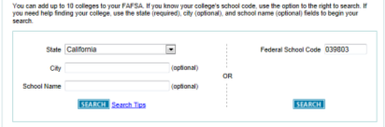
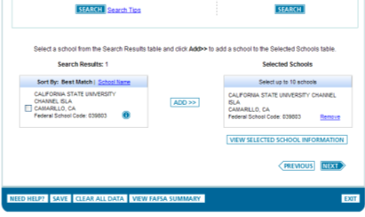
Parte 2
Selección de la Universidad
Cuando esté en la sección de selección de escuela, al estudiante se le pide que introduzca la ubicación y el nombre o el código de la escuela federal por cada escuela a la que él/ella desea que la información FOTW sea enviada
Si el estudiante no sabe el código federal de la escuela, anote el estado en el que el colegio/ universidad se encuentra y busque el código de la escuela federal por el nombre del colegio/universidad
Notes:
School Selection (cont)
Students will need to use a federal school code for each of the schools they list in Section 2. Students can look up their school codes when they are completing this section of the FOTW. Be sure to enter the state where the school is located to make the search for the name of the college or university easier. This will give the student the federal school code. Please note that this federal code number is different from the SAT, ACT, and CSS/Financial Aid PROFILE code numbers.

Slide 16
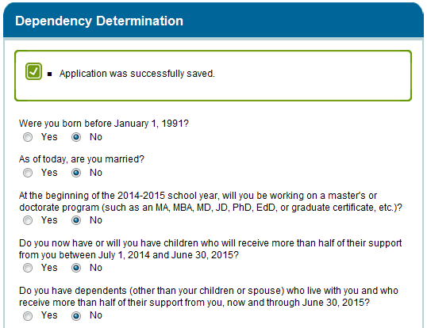
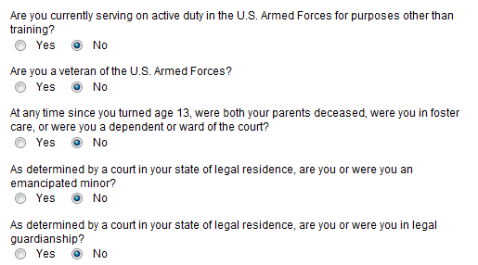
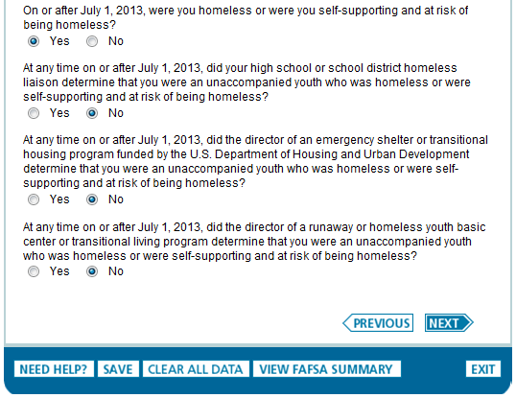

Parte 3
Determinación de la Condición de Dependencia del Estudiante
Notes:
NOTE TO PRESENTERS: At this point, read each of the dependency statements in Section 3 individually. The questions are listed over the next three slides.

Slide 17

Parte 4
Información de los Padres
¿Quien es considerado uno de los padres?
  Padres biológicos o adoptivos)
    Incluyendo personas del mismo sexo y parejas no casadas que viven juntas
  En caso de divorcio o separación, proporcione información sobre el padre y/o padrastro del estudiante con el que vivió más en los últimos 12 meses
  Padrastros (sin importar si hay algún acuerdo prenupcial), si está casado actualmente al padre de la custodia del estudiante
Notes:
Who is Considered a Parent
Before starting this section, listen carefully to help determine who is considered a parent in this section. Students and their parents must answer all the questions in Section 4 as of the date they complete and submit the FOTW. These instructions apply even if you do not live with your legal parents but are still required to provide parental information on your 2015-2016 FAFSA.
- If the biological or adoptive parents are both living and married to each other, answer the questions about both of them. This includes same-sex parents and all unmarried parents living in the same household.
- If the parent is widowed or single (that is, never married), answer the questions about that parent.
If the widowed or divorced parent is remarried as of the day the FAFSA is submitted, answer the questions about that parent and the person to whom the parent is married (the student’s stepparent).
- If the parents are divorced or separated, answer the questions about the parent the student lived with more during the past 12 months. If the student lived with both parents equally, submit financial data about the parent who provided the greater amount of support. If that parent is remarried, include stepparent information.
- The term "parent" is not restricted to biological parents. There are instances (such as when a grandparent legally adopts the applicant) in which a person other than a biological parent is treated as a parent, and in these instances, the parental questions on the application must be answered, since they apply to such an individual (or individuals).
- An adoptive parent is treated in the same manner as a biological parent on the FAFSA.
- A stepparent is also treated in the same manner as a biological parent if the stepparent is married, as of the date of application, to the biological parent whose information will be reported on the FAFSA, or if the stepparent has legally adopted the student. There are no exceptions. Prenuptial agreements do not exempt the stepparent from providing required data on the FAFSA. The stepparent's income information for the entire base year 2014 must be reported even if the parent and stepparent were not married until after the start of 2015, but were married prior to the date the FAFSA was submitted.
.

Slide 18
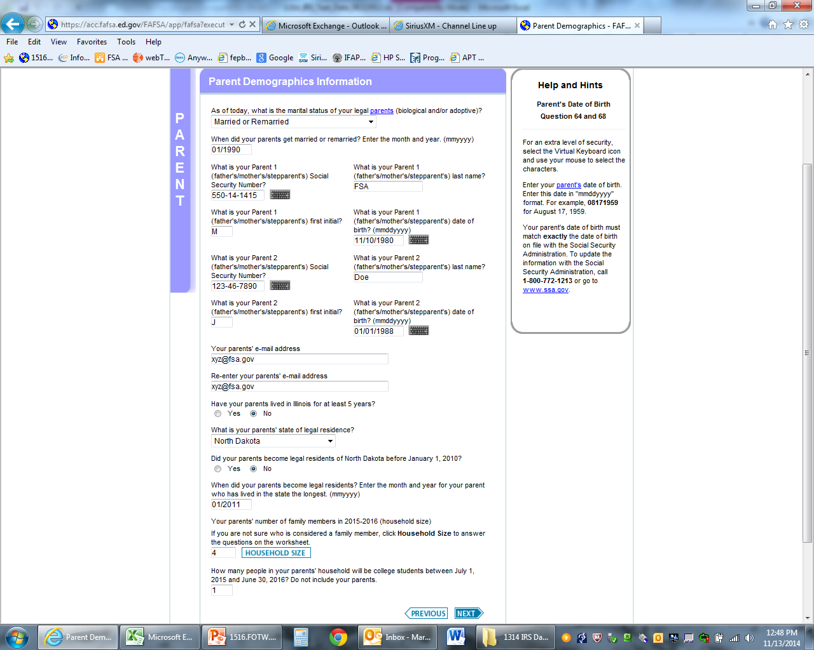
Parte 4
Información de los Padres
Si el estudiante está proporcionando información de padres, el estudiante necesitará de los padres:
    Números de Seguro Social
    Apellidos e iniciales
    Fechas de nacimiento
Notes:
Parents’ Information
If the student is providing Parent Information for Parent 1, father/stepfather, and/or Parent 2, mother/stepmother, he/she will need those parent(s’):
Social Security Numbers;
Last names and first initials; as well as
Dates of Birth.

Slide 19


Parte 5
Declaración de Impuestos de los Padres del 2014
2014
Al estudiante se le pedirá que proporcione información acerca del estado de la declaración de impuestos de los padres para el 2014:
  Si sus padres ya presentaron la declaración federal de impuestos del 2014, marque “Ha sido presentada”
  Si aún no la han presentado, pero planean presentar la declaración federal de impuestos del 2014, marque “Será presentada”
  Si no la han presentado, ni presentarán la declaración de impuestos federal del 2014, marque “No se va a presentar”
Notes:
Parents’ Tax Return Filing Status
In this question, students will be asked to provide information about their parent tax filing status for 2014:
If the parents have completed a 2014 federal income tax return, the parents should select “Already completed.”
If parents have not as yet filed, but plan to file a 2014 federal income tax return, they should select “Will file.”
If parents have not, nor will not, file a 2014 federal income tax return and are not required to do so, they should select “Not going to file.”

Slide 20

Parte 5
Ingreso Bruto Ajustado de los Padres para el 2014
2014?
Si sus padres aún no han presentado su declaración federal de impuestos para el 2014, puede calcular un estimado para la información de ésta pregunta
El “Estimador de Ingresos" en el FOTW puede ayudar a calcular esta cantidad
Si sus padres ya presentaron su declaración federal de impuestos para el 2014, use la información actual de la declaración de impuestos del 2014 para completar este artículo si no son elegibles para usar el proceso de Recuperación de Datos del IRS
Notes:
Parents’ 2014 Adjusted Gross Income
The next question asks about parents’ 2014 adjusted gross income (AGI).
For parents who have not yet completed their 2014 federal tax return, the FOTW site provides an AGI Income Estimator which makes it easy to calculate an estimated AGI.
Remember, if custodial parents have not yet filed their 2014 federal tax return, it is fine to use estimated 2014 income information on the FOTW. There will be sufficient time to update this information when the parents complete their actual 2014 federal tax return.
If parents have completed their 2014 federal tax return, they should use actual 2014 tax return information to complete this item – either by using the IRS Data Retrieval process or their actual 2014 federal income tax return.
This question asks specifically about parents’ 2014 AGI. That is, the total of all taxable income they will list on their 2014 federal income tax form. This figure includes their wages as well as other taxable income such as interest and dividend income, business and rental property income, unemployment, as well as the taxable portion of pensions, IRA distributions, and Social Security benefits.

Slide 21
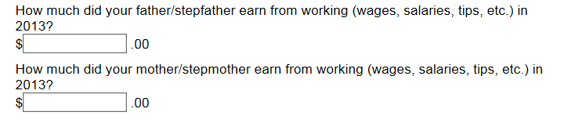





Parte 5 - Dinero Ganado a Través del Trabajo de los Padre(s) en el 2014
How much did your Parent 1 earn from working (wages, salaries, tips, etc.) in
2014?
How much did your Parent 2 earn from working (wages, salaries, tips, etc.) in
2014?
Utilice los formularios W-2 y otros documentos para determinar todos los ingresos del 2014, producto del trabajo (incluya los ingresos comerciales obtenidos de empleo por cuenta propia) para el Padre 1 and Padre 2
Notes:
Money Earned from Work by Parents(s) in 2014
These next questions ask about custodial parent earnings from sources such as wages, salaries and tips. These questions must be answered whether or not the parents file a tax return. This information may be on their W-2 forms, or on IRS Form 1040, 1040A, or 1040EZ.
Parents who own a business or farm should report any income from these sources here as well so that Social Security taxes paid can be properly calculated.
It is important to list earnings correctly, because when the U.S. Department of Education calculates the parents' Expected Family Contribution (EFC), certain allowances are subtracted from the parents' income for required taxes and necessary expenses (such as income and Social Security taxes and basic living costs). The parents' income earned from work will also be used in the EFC calculation as an income factor when no tax form is filed.
Note to Presenters: FOTW asks separate questions about Parent 1 and/or Parent 2 income from earnings. These questions are combined on the slide.

Slide 22
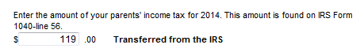
Parte 5 - Impuestos de Ingresos de los padres en EE.UU. del 2014
Ingrese el importe pagado por los padres en la declaración federal de impuestos del 2014
  Utilice la declaración federal de impuestos pagada (o por pagar), no la cantidad retenida de los cheques de los padres
Notes:
Parents’ 2014 U.S. Income Taxes
For this important question, students are asked to report parents’ federal income tax for 2014. Students should make sure to use U.S. income tax paid (or to be paid)—not the amount withheld by employers or pre-paid by self-employed parents and to report the information that matches the reference to the line number on the IRS tax return..

Slide 23
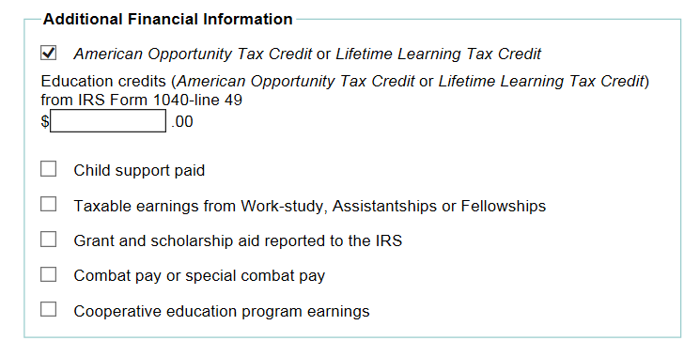
Parte 5
Información Adicional Financiera del 2014
Al estudiante se le pedirá que informe si sus padres recibieron o pagaron cualquiera de los siguientes artículos en el 2014. Marque todas las que apliquen y proporcione cantidades.
  Créditos de impuesto America Opportunity, Lifetime Learning
  Sustento Económico pagado para un hijo
  Ingresos tributables de estudio-trabajo, ayudantías, o becas
  Ayuda de Subvenciones y becas reportadas al IRS
  Pago de combate o pago especial de combate
  Ganancias del programa de educación cooperativa
Notes:
2014 Additional Financial Information
This Additional Financial Information question asks about information not included as part of parental income when calculating student need. For example, if either of the custodial parents is paying child support for a child in another household, this amount will be subtracted from the total custodial parent income.
The parent(s) should check all that apply. The parent(s) may be asked to report their annual 2014 amounts for all boxes checked.

Slide 24
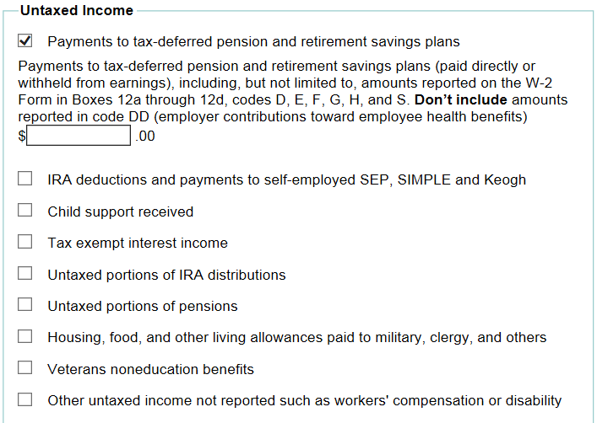
Parte 5
Ingresos Libres de Impuestos del 2014
Al estudiante se le pedirá que informe si sus padres tenían un ingreso no tributable en el 2014. Marque todas las que aplican. Algunos ejemplos más comunes son:
  Los pagos a los impuestos diferidos y planes de pensiones de ahorro como 401K
  Deducciones del IRA, y los pagos a trabajadores por cuenta propia SEP y Keogh
  Sustento de menores recibido
  Ingreso por interés exento
  La vivienda, alimentación y subsistencia pagada a los miembros de las fuerzas militares y el clero
Notes:
2014 Parent Untaxed Income
This 2014 Untaxed Income Information section asks questions about untaxed income the custodial parents earned or received. Parents should be sure to include pre-tax contributions they (not employers) have made to 2014 tax-deferred pensions, retirement savings plans, IRAs and Keoghs.
Additionally, parents should include other untaxed income such as child support received in 2014 for all children (including the student), tax exempt interest income, housing/food and other living allowances paid to military and clergy as well as any income not reported elsewhere on the form.
Some colleges and universities may ask for information about other untaxed income, such as untaxed foreign income. They may also request documentation of any information reported here.
The student should check all that apply. Online at FAFSA on the Web, the student may be asked to report his or her parents’ annual 2014 amounts for all boxes checked.

Slide 25

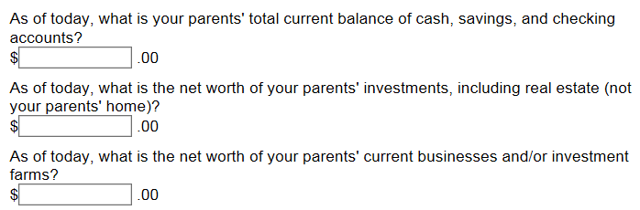
Parte 5
Bienes de los Padres
Si se les pregunta, los estudiantes deben reportar los saldos actuales en efectivo de sus padres, ahorros y cuentas corrientes a partir del día que ellos completen el FOTW
También se les puede pedir que proporcione información sobre el valor neto de las inversiones de los padres tales como bienes raíces, propiedad de alquiler, mercado de dinero y fondos mutuos, acciones, bonos y otros valores
Además, se les puede pedir información sobre el valor neto de sus empresas y granjas de inversión
No deben incluir la casa en la que viven, el valor de los seguros de vida y planes de jubilación, o el valor de un negocio pequeño y controlado por la familia
Notes:
Parent Assets
Students may be asked to provide information about their parents’ assets depending on their parents’ level of income.
An asset is defined as property that has an exchange value. The purpose of collecting asset information is to determine if the family’s assets are substantial enough to support a contribution toward the student’s educational expenses.
Assets fall into three categories for the FAFSA on the Web. These are:
Cash, savings and checking
Investments
Business or Investment farm value
Cash, savings and checking are liquid funds that parents have as of the day the student and his or her family complete the FAFSA.
Investments include some of the following: real estate (other than the parents’ primary home), trust funds, UGMA and UTMA accounts, money market and mutual funds, certificates of deposit, stock and stock options, bonds and other securities, Coverdell Education IRAs, college savings plans including 529(c) plans owned by parents, installment and land sale contracts, and commodities.
Business and investments farms include the market value of land, buildings, machinery, equipment, and inventory. Debt means only those debts for which the business/investment farm was used as collateral.
Keep in mind that only the net worth (the current value minus debt) of assets should be reported.
Remember, parents should not report assets such as the family home, the value of any life insurance, or the value of a family-owned and controlled small business . (A small business is defined as one with 100 or fewer full-time or full-time equivalent employees). And, most importantly, any accumulated funds in retirement accounts such as Roth or traditional IRAs, pension funds, Keogh, 401K, 403B, or other plans should not be reported.

Slide 26
Parte 5
Información Financiera del Estudiante
Las preguntas de la Parte 5 son idénticas a las de las finanzas de los padres
  Si el estudiante es casado(a), también reporte el ingreso y bienes de su cónyuge
Las preguntas de la Parte 5 también piden:
  Cual declaración de impuestos federales del 2014 el estudiante ha presentado o presentará
  El ingreso bruto ajustado en el 2014 del estudiante, si esta presentando la declaración federal de impuestos, y los ingresos de trabajo, así como los ingresos y bienes libres de impuestos
Notes:
Student Financial Information
The student questions in Section 5 concerning student finances are identical to those for the parents we have already covered. We will not review the student income information in this section in any detail.
If the student is married at the time the FOTW is submitted, the spouse’s 2014 income and current value of combined student and spousal assets must be included, even if the student was not married in 2014.
How many students here today are considered independent for purposes of completing the FOTW?
NOTE TO PRESENTERS: Based on the number of participants in the audience who respond affirmatively to being independent, either have the students see you after the formal presentation or review Slides 90-94 at this point.

Slide 27
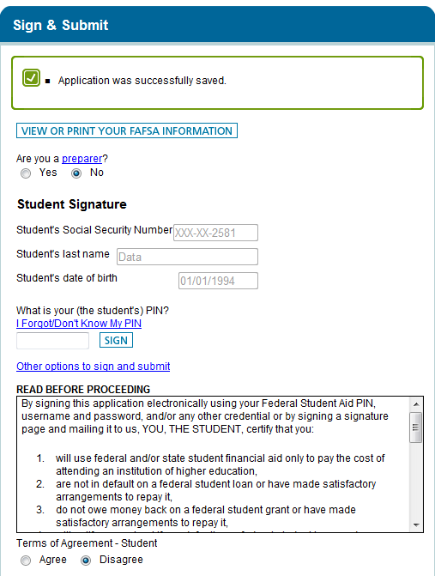
Parte 6
Página con la Firma
Firme y Presente
  Se recomienda que los estudiantes firmen la FAFSA electrónicamente usando su PIN
  Recuerde leer y marcar "Acepto"a los Términos del Acuerdo del estudiante
  Uno de los padres tambien necesita firmar con on PIN
Notes:
Student Signature Page
It is important that both students and their custodial parents read the FAFSA on the Web Certification Statement before submitting the FAFSA. They should be sure they understand to what they are agreeing.
All students (and at least one of their custodial parents, if dependent) must sign the FAFSA. When submitting the FOTW, students and at least one of their custodial parents must provide their own individual PINs. Remember, students and their custodial parents can get their PINs at www.pin.ed.gov or when they complete the FOTW. Students and parents should not share their PINs with anyone else.
We recommend signing the FAFSA electronically with the student PIN, so the student applicant does not need to print, sign, and mail a signature page.
Also, make sure to read and mark “Agree” to the student Terms of Agreement.

Slide 28
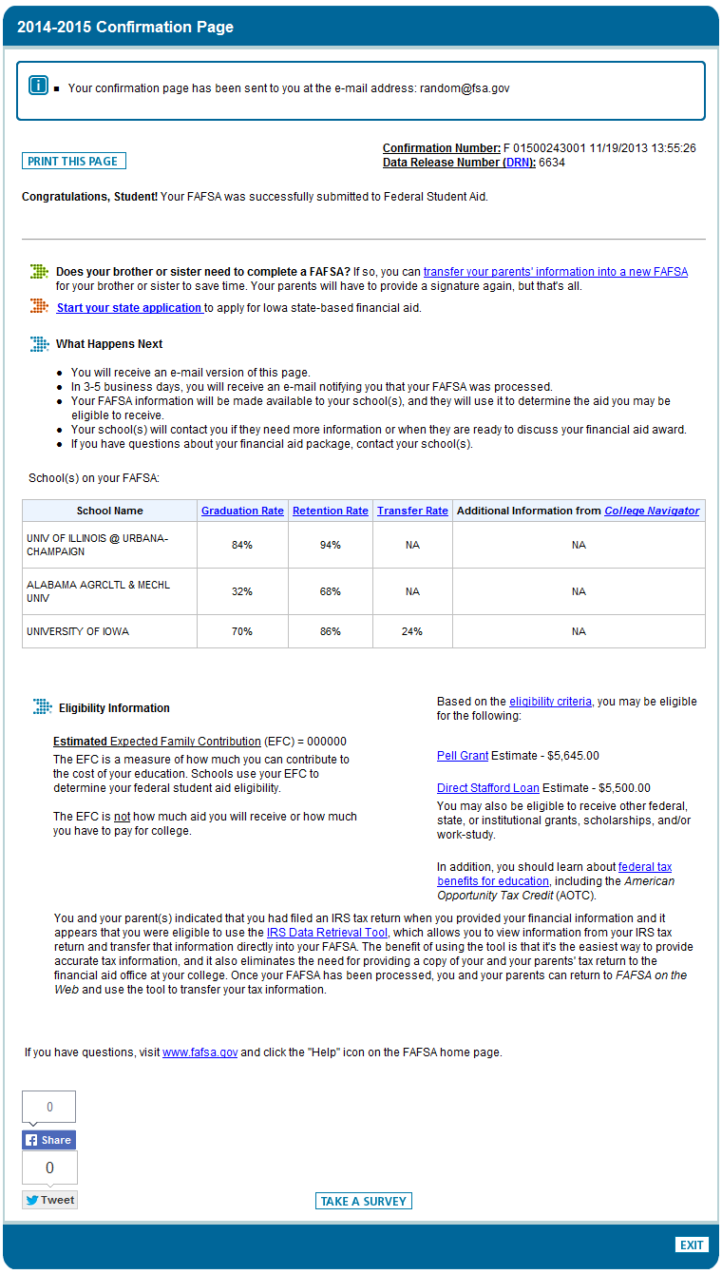
Parte 7
Confirmación
2015-2016 Confirmation Page
Página de Confirmación
  Confirma la fecha y hora de presentación de la FOTW al Departamento de Educación de EE.UU
  Enseña
    Contribución Familiar Esperada (EFC)
    )
    Estimado de la Beca Federal Pell y elegibilidad para Prestamos Federales Stafford
    Lista de las escuelas que recibirán datos de la FAFSA
Notes:
Confirmation Page
The student should choose to print the Confirmation Page and save a copy.
This page confirms the date and time of submission of the FOTW to the U.S. Department of Education.
In addition, it shows the student’s Expected Family Contribution (EFC), estimated Federal Pell Grant and Federal Stafford Loan eligibility, as well as
the list of schools scheduled to receive FAFSA data. The Confirmation Page also indicates important information about each college or university listed.
Each time a student makes FOTW corrections, a new Confirmation Page will be available which will reflect the changes made.

Slide 29

Circunstancias Especiales
Póngase en contacto con la Oficina de Ayuda Financiera si hay circunstancias que afectan a la capacidad de la familia para pagar la universidad, tales como:
  Una pérdida o reducción de los ingresos o bienes del padre o del estudiante
  Una muerte o una enfermedad grave
  Los desastres naturales que afectan los ingresos o bienes de los padres tales como los recientes incendios, tormentas de vientos, inundaciones, y deslaves en California
  Los gastos médicos o dentales inesperados no cubiertos por el seguro
  Reducción de la manutención para los hijos u otros beneficios no sujetos a impuestos
  La responsabilidad financiera de sus abuelos, o
  Cualquier otra circunstancia que afecte la posibilidad de la familia para contribuir a la educación superior
Notes:
Special Circumstances
Many families have special circumstances not reflected by the questions on the FAFSA. Families are encouraged to contact the Financial Aid Office at each of the schools to which they are applying for admission and financial aid if there are significant changes in their circumstances such as:
A loss or reduction in parent or student income or assets
A death or serious illness
Natural disasters that affect parent income or assets – this is especially true for any family adversely affected by the recent California wind storms, wildfires, floods, or mudslides
Unusual medical or dental expenses not covered by insurance
Reduction in child support or Social Security benefits
Financial responsibility for elderly grandparents, or
Any other unusual circumstances that affect a family’s ability to contribute to higher education.
If the family feels there are special circumstances that may affect their ability to contribute to college, it is important that they present their case in a way that helps the financial aid office understand their unique challenges. Some schools will provide special forms to help the family provide the appropriate new information. Families are encouraged to:
Contact the financial aid office for guidance
Write a detailed explanation of circumstances
Include student’s name, college or university ID#, and date of birth
Give specific financial details including the reasons why the circumstances affect the family’s ability to contribute
Attach supporting documentation
Send to the financial aid office at each school to which the student is applying for admission and financial aid
Each financial aid office will make its own decision about the effect the special circumstances have on a student’s need. Not all aid offices will be able to provide additional funds if there are special circumstances, but they might be able to suggest other options.

Slide 30
¿Qué Sucede Después?
Los estudiantes y las universidades que enumeró el estudiante reciben reporte de ayuda financiera (SAR) del procesador federal
ê
Los estudiantes que llenen la FAFSA y el Formulario de Verificación del GPA de Cal Grant reciben un Reporte de Ayuda de California (CAR)
ê
Los estudiantes y las familias revisan el SAR y el CAR para obtener información importante y verifican que contengan los datos correctos
ê
Las universidades comparan los registros de admisión con la FAFSA y con otras solicitudes de ayuda financiera y determinan la elegibilidad para la ayuda
ê
Las universidades mandan notificaciones de elegibilidad a los estudiantes admitidos que hayan llenado todos los formularios de ayuda financiera
Notes:
What Happens Next
Shortly after completing the FOTW, the student should receive a Student Aid Report (SAR) from the federal processor. The SAR summarizes the information the family provided on the FAFSA. Each school listed on the SAR will also receive the information electronically. If the student does not receive the SAR within two weeks, he/she should contact the federal processor to check on the status of the FAFSA. Call 1-800-4-FED AID (that’s 1-800-433-3243) or check on the status of your FAFSA by going to FAFSA.gov using the student PIN.
When the California Student Aid Commission evaluates the student’s FAFSA and Cal Grant GPA Verification Form, the student will receive a California Aid Report (CAR) that will provide the student with information about his/her Cal Grant eligibility.
Students who complete the CA Dream Act Application will be able to view their CalSAR immediately upon submitting their application.
Once each school receives the electronic SAR and all other required financial aid forms, and confirms the student’s admission status, the financial aid office will determine the student’s financial aid eligibility. Some schools may request that the student submit income documentation such as student and parent 2014 federal income tax returns (including W-2s and all schedules and attachments) or 2014 Federal IRS Tax Transcripts, before sending the student a final determination of eligibility. The school will use these and any other requested information to verify the accuracy of the data provided on the FAFSA. Schools understand that many families have used estimated data.
A financial aid notification (commonly referred to as an award letter) describing the amounts and sources of aid the student has been awarded will be prepared for the student when the student’s financial aid application is complete. Most schools will wait until the student has been accepted for admission to notify him or her about financial aid eligibility. Some schools will mail a paper notification to the student; others may provide the award letter electronically.
In some cases, the student will be required to sign and return a copy of the financial aid notification, indicating whether he/she accepts or declines each source of aid.
If family circumstances change after the student completes the FAFSA and other required financial aid documents, make sure to contact the financial aid office at each school as soon as possible.

Slide 31
Verificación Federal
Algunos estudiantes pueden ser requeridos para verificar la información proporcionada en la FAFSA
Si es seleccionado para la verificación, la información fiscal de los contribuyentes de impuestos federales se verificará a través de
  El Proceso de Recuperación de Datos del IRS o
  Transcripción de Impuesto del IRS sí lo solicita el colegio o universidad
A familias que no sometan la declaración federal de impuestos y son seleccionados para verificación, se le puede pedir que proporcionen
  Declaración firmada que confirme que no presentó una declaración federal de impuestos de 2014 y no estaban obligados por el IRS para hacerlo
  Copias de los formularios W-2 de cada empleador, si obtuvo algún ingreso de trabajo
Todos los solicitantes de ayuda seleccionados también se le pedirá que verifiquen alguna información de datos como
  Tamaño de la familia y el número en la universidad
  Manutención de menores pagada y SNAP, si se reportaron en la FAFSA
  Historia de inscripción para los estudiantes de transferencia
  Confirmación de identidad
Notes:
Federal Verification
In order to assure that information provided by students and parents is accurate, the U.S. Department of Education requires colleges and universities to verify the accuracy of financial and other demographic information provided on the FAFSA. Verification of FAFSA data helps colleges and universities accurately and equitably determine the types and amounts of federal funding students will receive. Students whose FAFSA data is chosen for Verification will see an asterisk next to the EFC on their SAR.
If selected for verification, the tax information of federal tax filers will be verified through
The IRS Data Retrieval Process, or
IRS Tax Transcripts if requested by the college or university.
Federal Tax Transcripts are available free of charge at:
www.irs.gov/individuals/order-a-transcript
or by calling 1-800-908-9946.
Non-Tax filers selected for verification may be asked to provide
Signed statements confirming that they did not file a 2014 federal tax return and were not required by IRS to do so; and
Copies of W-2s or other documentation from each employer, if any income was earned from work.
All selected aid applicants will also be asked to verify certain demographic data listed such as
Household size and number in college,
Child Support paid and SNAP, if reported on the FAFSA
Enrollment History for transfer students
Identity Confirmation.
Some colleges and universities may require the verification of additional information for determining eligibility for state and their own student aid funds.

Slide 32
Verifique Su Cal Grant
Al abrir una cuenta WebGrants el estudiante puede:
Revisar el estado de su Cal Grant 24/7
Confirmar su graduación de la escuela secundaria según sea necesario
Realizar cambios en opciones de escuelas Cal Grant
Ver el valor de una beca de Cal Grant en diferentes colegios y universidades de California
Ver su historial de pagos de Cal Grant
Crear una cuenta de WebGrants en: www.webgrants4students.org
Notes:
Check Your Cal Grant
Students are encouraged to open a WebGrants account to manage their Cal Grant. After doing so, they can
- Check their Cal Grant application and award status 24/7
- Confirm their high school graduation as is required to receive Cal Grant payment
- Make changes to their Cal Grant school choices
- View how much their Cal Grant may be worth at different California colleges and universities as well as
- View their Cal Grant payment history
In addition, they can click on links to other financial aid information and web sites.
Students can create a WebGrants account at: webgrants4students.org

Slide 33

Q & A
Q & A
Q
&
A
Q
&
A
Q
&
A
Q
&
A
?
Q & A
Q & A
Notes:
Questions and Answers
We hope you have found this workshop helpful.
We will now be glad to answer any general questions you and your family might have.
After a brief question and answer period, volunteers will be available to help you complete the 2015-16 FAFSA on the Web, the 2015-16 Cal Grant GPA Verification Forms, and answer any questions about other financial aid documents.

